Slide 1

Local Wellness Policy
Part 1 Training
Notes:
Welcome to the AZ Health Zone WellSAT Policy Training, Part 1! Let’s get started. This training will cover the background and implementation of local wellness policy work, including wellness committees and SHACs, the triennial assessment, and the WellSAT Policy. Let’s dive in!

Slide 2
Agenda
What is a wellness policy?
Background
WSCC Model
Arizona Department of Education Triennial Assessment
The LIA’s Role
SHACs
AZ Health Zone & WellSAT Policy
Capacity Building
Community Engagement
Resources
Notes:
Here is our agenda for this training: 1.What is a wellness policy? Here, we will review the
Background
SHACs, and
WellSAT Policy and AZ Health Zone
Arizona Department of Education Triennial Assessment, brought to you directly from the department.
The LIA’s Role this will cover the
Scope of Work
When to use WellSAT Policy, and
Capacity Building. Finally, we will cover
Community Engagement, and
Resources

Slide 3
What is a Local Wellness Policy?
Notes:
To start us off, we will learn, what is a local wellness policy?

Slide 4
What is a Local Wellness Policy?
A local wellness policy (LWP) is a document created by a Local Education Agency (LEA) or district, that documents the policies and efforts to establish an environment that promotes students’ health, well-being, and ability to learn.
Notes:
A local wellness policy (LWP) is a document created by a Local Education Agency (LEA) or district, that documents the policies and efforts to establish an environment that promotes students’ health, well-being, and ability to learn.
A local wellness policy must specifically address goals for: Nutrition education Physical Activity Nutrition guidelines for all foods and beverages available (meaning provided and/or sold) at school including:
School meal standards and the smart snacks in school nutrition standards
Policies on marketing
Description of public involvement, public updates, policy leadership, and evaluation plan. Other school based activities designed to promote student wellness Plans for evaluating or implementing the policy

Slide 5



Background
Strong local wellness policy
Healthy School
Healthy Students
Notes:
Research shows that a strong local wellness policy encourage healthy school systems and environments which encourages students to be more physically active, while choosing more nutritious food and beverages for consumption.

Slide 6
Background
2010 Healthy Hunger Free Kids Act
Mandates use of local wellness policy for all operators of National School Lunch or Breakfast Program
Triennial Assessment
Triennial assessment
Public posting and feedback on LWP
Assessment of policy strength and comprehensiveness
Assessment of policy implementation
Notes:
2010 Healthy Hunger Free Kids Act was signed into law. This law, which is governed by USDA:
Mandates the use of local wellness policy for all operators of National School Lunch or Breakfast Program
It also mandates a Triennial Assessment of the local wellness policy
Triennial assessment includes
Evaluation of public posting of the local wellness policy and making sure sure each local education agency makes a feedback opportunity available for the public to comment on the LWP and updates
Assessment of policy strength and comprehensiveness must happen once every three years (this is what we use the WellSAT Policy for)
Assessment of policy implementation must also occur every three years
While USDA governs the local wellness policy federally, the federal guidance is enforced at the state level through Arizona Department of Education, who issues the triennial assessment.
Additionally, Local Wellness Policy Work aligns with the SNAP-Ed evaluation framework indicators, and therefore is supported by SNAP-Ed nationally

Slide 7
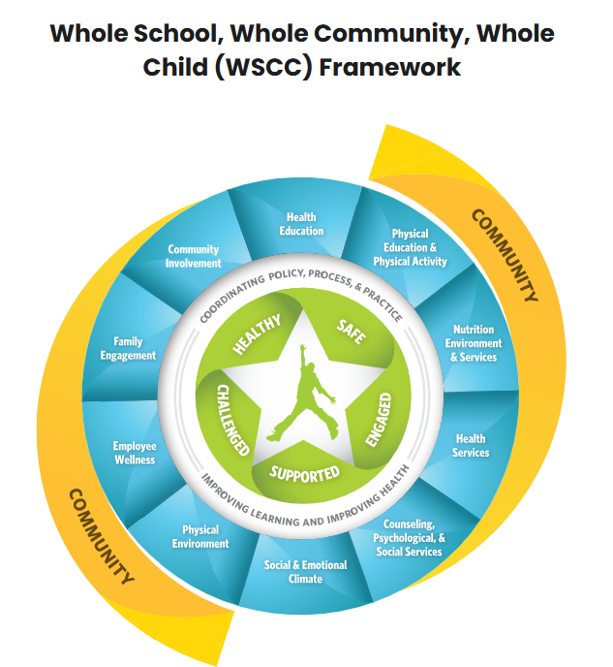
Notes:
The WSSC model, created by the CDC, shows the importance of the school and community on child health.
There are 10 components to the WSCC model – Health education; physical education and physical activity; nutrition environments and services; health services; counseling, psychological & social services; social & emotional climate; Physical environment; Employee wellness; family engagement; and community involvement.
AZ Health Zone works in the following areas of the chart:
Physical Education & Physical Activity
Nutrition Environment & Services
Physical Environment
Family Engagement, and
Community Involvement
It’s important to know that in the broader areas of this model, such as family engagement and community involvement, our role is still limited to support nutrition and physical activity access and education, and to not going beyond the scope of SNAP-Ed. Depending on the needs of your site partners, there may be ways you can creatively support other areas of the WSCC model that still fall within the scope of AZ Health Zone work.
The WSCC Framework is a great starting place for local wellness policy focuses to guide your districts’ work for student health.

Slide 8
Arizona Department of Education
Triennial Assessment of the Local Wellness Policy
Notes:
Thank you for the opportunity for us at the Arizona Department of Education to collaborate on this training with AZ Health Zone on the Local Wellness Policy. We recognize the importance of your work around community wellness and will be sharing with you how we measure compliance of the LWP through the triennial assessment and the Administrative Review.

Slide 9
Triennial Assessment and the LWP
The Final Rule requires State agencies to assess compliance with the LWP requirements as part of the general areas of the Administrative Review (AR).
LEAs must conduct an assessment on the LWP every 3 years. To determine:
Compliance with the LWP
How the LWP compares to a model policy
Progress made in implementation of the LWP
*It has been communicated that ADE conducting LWP outreach during a review year may be overwhelming for the SFA, but LIAs may have a better opportunity to provide TA on LWP compliance during a review year.
Notes:
As previously stated, Local educational agencies (LEA) participating in the National School Lunch Program and/or School Breakfast Program are required to develop a local school wellness policy that promotes the health of students and addresses the problem of childhood obesity. Wellness policies are tailored to the unique needs of each LEA and present an opportunity to improve the health of each community.
o The Final Rule requires State agencies to assess compliance with the LWP requirements as part of the general areas of the Administrative Review (AR).
o LEAs must conduct an assessment on the LWP every 3 years.
o To determine:
§ Compliance with the LWP
§ How the LWP compares to a model policy
§ Progress made in implementation of the LWP
o *It has been communicated that ADE conducting LWP outreach during a review year may be overwhelming for the LEA, but LIAs may have a better opportunity to provide technical assistance on LWP compliance during a review year.

Slide 10
Triennial Assessment vs Administrative Review (AR)
ADE Health and Nutrition Services will annually post the AR schedule.
Where to find: National School Lunch Program and School Breakfast Program | Arizona Department of Education
Additionally, a separate Procurement Review is performed along with the AR.
The AR is a formal evaluation conducted by the state agency to assess compliance with all Federal school meal program requirements at least once during each five-year review cycle, including the Local Wellness Policy
The Triennial Assessment is a self-evaluation conducted by LEAs to measure the implementation and effectiveness of the LWP
Notes:
While it is the intention to foster a wellness culture within the school environment, our primary role as the state agency administering the National School Lunch Program is to assess compliance through the process of the Administrative Review (AR).
o So, what is the AR? The AR is a formal evaluation conducted by the state agency to assess compliance with all Federal school meal program requirements at least once during each five-year review cycle, including the Local Wellness Policy
o AR will assess the LEA’s LWP through the triennial assessment which a self-evaluation conducted by the LEA to measure the implementation and effectiveness of the LWP
o ADE Health and Nutrition Services will annually post the AR schedule at the beginning of the school year.
o Linked on this page is where you can locate if your partnered school is scheduled for an AR
Additionally, a separate Procurement Review is performed along with the AR. This review does not include the LWP.

Slide 11
What is the Activity and Assessment Tool and how to utilize it
This tool is designed to be an action plan that guides implementation, strength, and comprehensiveness of the LWP.
Reflect on performance, “Did we do this?”
Use this list of actions to select from when writing goals and policies in the LWP.
Select at least one action from each section; selecting all actions is not required.
LEAs are required to have a written LWP, this tool aids in the assessment of what it written in the policy
Development: choose activities to implement and determine how to work toward implementation. Then, use the activities selected to write a goal in each area on the LWP Template.
Assessment: record the number of schools that successfully completed the action(s) selected.
Notes:
What is the Assessment Activity Tool (AAT) and how is it utilized?
o This tool aids LEAs in the assessment of what is written in the LWP
§ Development: choose activities to implement and determine how to work toward implementation. Then, use the activities selected to write a goal in each area on the LWP Template.
§ Assessment: record the number of schools that successfully completed the action(s) selected.
§ This tool is designed to be an action plan that guides the implementation, strength, and comprehensiveness of the LWP.
§ Reflect on performance, “Did we do this?”
§ The AAT may be used as a list of actions (ideas) to select from when writing goals and policies in the LWP.
§ Select at least one action from each section; selecting all actions is not required.
This tool is provided to all federally funded meal program recipients, and ADE will prioritize referencing its own resources. While LIAs may choose to use the WellSAT, it may be beneficial for them to become familiar with AAT and related resources as these may be commonly used and referenced.

Slide 12
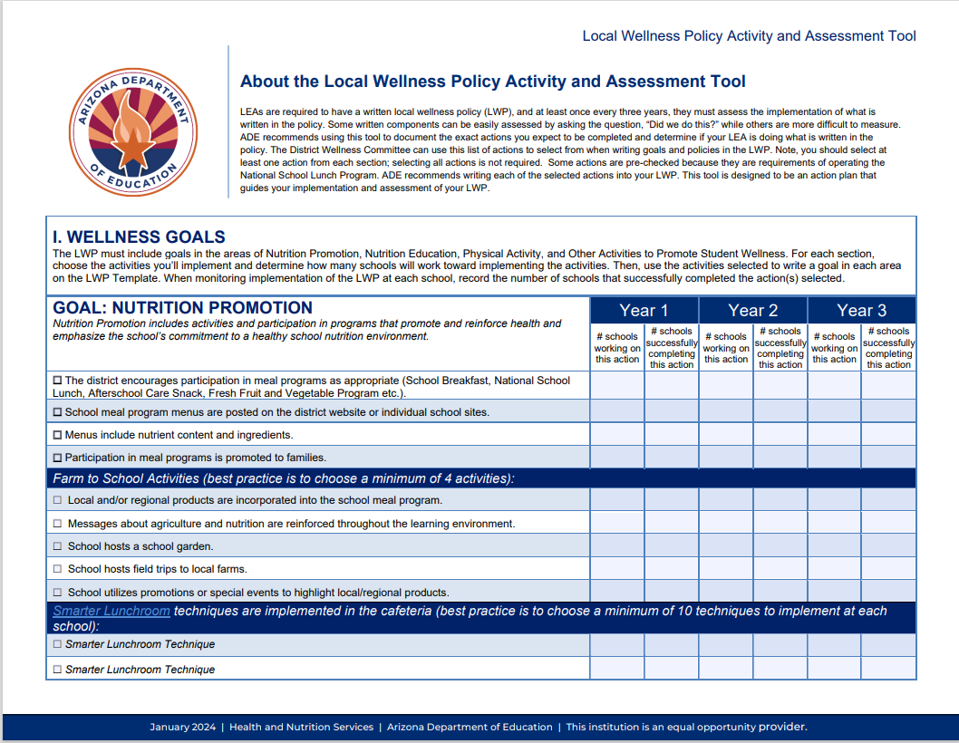
LWP Activity and Assessment Tool
The intention of this tool is to support continuous improvement of the LWP by identifying strengths and opportunities to enhance student wellness initiatives.
ADE Activity and Assessment Tool
Notes:
For convenience, we have added a link to the AAT here. This tool is a thorough 18-page document. Again, it is important to note that not all activities are required. There is also space within this tool to add activities or goals that are not listed and customized to your school.

Slide 13
USDA Administrative Review (AR) Off-Site Assessment Questions
The Off-site Assessment Tool contains questions about and requests for information from the SFA regarding several of the monitoring areas of the Administrative Review
The AR will request answers to 6 questions regarding the LWP
These questions include: If a policy is in place, minimum requirements are met, if policy is open to the public, how and when a review of policy is made, who is involved in the review and updates of the policy, who are the stakeholders, and if a copy of the review if open to the public
USDA AR Off-site Assessment Questions
The USDA or the State Agency may modify these questions year to year
Notes:
USDA Administrative Review (AR) Off-Site Assessment Questions. During the AR, along with the On-site Review there is an off-site portion. This portion contains questions about and requests for information from the LEA[BJ1] regarding several of the monitoring areas of the Administrative Review including the LWP
§ request answers to 6 questions regarding the LWP
§ These questions include:
§ If a policy is in place
§ minimum requirements are met
§ if policy is open to the public
§ how and when a review of policy is made
§ who is involved in the review and updates of the policy
§ who are the stakeholders
§ and if a copy of the review if open to the public
§ The USDA or the State Agency may modify these questions year to year

Slide 14
LWP Minimum Requirements to meet Federal Regulations
Specific Goals for:
Nutrition Promotion
Nutrition Education
Physical Activity
Other Activities that promote student wellness
Standards and nutrition guidelines for all foods and beverages
School meal nutrition standards
Smart Snacks
Standards for all foods and beverages provided, but not sold, to students
including foods given as incentives
Policies for food and beverage marketing
Description of public involvement, public updates, policy leadership, and evaluation plan
ADE LWP Template
Notes:
LWP Minimum Requirements to meet Federal Regulations
Specific Goals for:
Nutrition Promotion
Nutrition Education
Physical Activity
Other Activities that promote student wellness
Standards and nutrition guidelines for all foods and beverages
School meal nutrition standards
Smart Snacks
Standards for all foods and beverages provided, but not sold, to students
including foods given as incentives
Policies for food and beverage marketing
Description of public involvement, public updates, policy leadership, and evaluation plan
o The ADE LWP Template is linked below. This will help guide the LEA to create a LWP with all required components.

Slide 15
ADE Required Documentation
Documents required for the LWP portion of the Triennial Assessment:
Copy of the current LWP
Description of how the policy and assessments are made available to the public
Comparison to model policy or WellSAT policy
Description of efforts to review and update the LWP, including all parties involved and how stakeholders were made aware of ability to participate
Most current (past 3 years) assessment of implementation.
Activity and Assessment Tool (AAT) or WellSAT Practice
Notes:
*ADE will prioritize and direct SFAs to ADE developed resources. *Other tools available for assessment of implementation.

Slide 16
Administrative Review Summaries | Arizona Department of Education
Common AR Summary Report Findings:
Missing elements: Nutrition Promotion and Other Activities that promote student wellness.
Public involvement, Wellness committee is open to the public and stakeholders.
Public access to view LWP and/or LWP assessment.
LWP not evaluated, no plans to evaluate.
Notes:
If you are curious about the AR results of a school you are working with you can find the publicly available Administrative Reviews, linked here.
Common AR Summary Report Findings:
§ Missing elements: Nutrition Promotion and Other Activities that promote student wellness.
§ Public involvement, Wellness committee is open to the public and stakeholders.
§ Public access to view LWP and/or LWP assessment.
§ LWP not evaluated, no plans to evaluate.

Slide 17
Nutrition Promotion VS Nutrition Education
Nutrition Promotion includes activities and participation in programs that promote and reinforce health and emphasize the school’s commitment to a health school nutrition environment. Nutrition education teaches behavior-focused skills and may be offered as part of a comprehensive, standards-based program designed to provide students with the knowledge and skills necessary to safeguard their health and make positive choices regarding food and nutrition, or nutrition education can be offered as sequential individual lessons throughout the school year.
Notes:
One of the most common findings within the LWP portion of the AR is missing Nutrition Promotion.
o Nutrition Promotion includes activities and participation in programs that promote and reinforce health and emphasize the school’s commitment to a health school nutrition environment.
o Whereas Nutrition education teaches behavior-focused skills and may be offered as part of a comprehensive, standards-based program designed to provide students with the knowledge and skills necessary to safeguard their health and make positive choices regarding food and nutrition, or nutrition education can be offered as sequential individual lessons throughout the school year.
o This may provide you with an opportunity to introduce nutritional promotion such as Smarter Lunchroom Movement

Slide 18
LWP Administrative Review (AR) Findings SY 24-25
Projected Statistics:
60% of LEAs had LWP findings
38% of LEAs had missing LWP requirements
17% did not evaluate or update the LWP
Notes:
We reviewed the AR LWP findings of SY24-25 and here are some projected statistics. Please note that these numbers are not complete as reviews are still on going.
o 60% of LEAs had LWP findings
o 38% of LEAs had missing LWP requirements
o 17% did not evaluate or update the LWP
o This may be useful to know when approaching your schools with the LWP

Slide 19
ADE Resources
ADE LWP template
ADE Assessment Tool
Local Wellness Policy Assessment Comparison with a Model Policy
School Wellness Report Card
USDA Off-site Assessment Tool
Notes:
Here is a list of ADE resources. It is important to note that some ADE resources may be duplicative with WellSAT policy and practice, however exposure to both formats can offer valuable insights. We at ADE, encourage cross agency learning and awareness to strengthen collaboration and promote wellness within our communities.

Slide 20
Thank you
Becky Jacobs, NDTR
Health and Nutrition Services Specialist
Arizona Department of Education Health and Nutrition Services
602-542-2111
Becky.Jacobs@azed.gov

Slide 21
School Health Advisory Councils (SHACs)
Notes:
Let’s learn about what a school health advisory council is!

Slide 22
SHACs
School Health Advisory Councils, also known as Wellness Committees
Must operate at the district level
Optional school-based committee
Include various members of the school community
Meet quarterly
Responsible for maintenance, evaluation, and implementation of LWP
Energize the policy with new initiatives
Notes:
A SHAC is short for School Health Advisory Council. You might hear some people say as a “SHAC-D” to represent their SHAC being at the district level. A SHAC is a gathering of school stakeholders that is responsible for the local wellness policy. A SHAC can also be known as Wellness Committee - these terms are interchangeable. Here are some important facts about wellness committees:
SHACs and wellness committees must operate at the district level, because the local wellness policy operates at the district level
School-based committees and SHACs are optional. Some schools may find it helpful to have their own committee and policy if they inspired to do so.
The SHAC should include various members of the school community including administrators, teachers, and staff, including food service staff, counselors, P.E. teachers, nurses and custodians. Other members should be relevant vendors, individuals who live close to school adn are impacted by it’s policies, students and their caretakers. If you have other stakeholders, invite them to a committee meeting!
SHACs should meet at least Meet quarterly
And are responsible for maintenance, evaluation, and implementation of LWP
Finally, SHACs should energize the policy with new initiatives! If there are new initiatives, amending or implementing existing policies that have been paused is a great way to promote health in your schools.

Slide 23
WellSAT Policy and AZ Heath Zone
Notes:
Next we will review what the WellSAT Policy is, what it accomplishes, and how the AZ Health Zone uses it.

Slide 24
WellSAT Policy
Federal Requirements
Nutrition Environment
& Services
Wellness School Assessment Tool (WellSAT)
An online tool to evaluate wellness policies
Encompasses nutrition and physical activity
Compares against a model policy
Can be used to facilitate the triennial assessment of local wellness policies
Employee Wellness
Nutrition Education
Physical Education &
Physical Activity
Implementation & Coordination
Notes:
Wellness School Assessment Tool (WellSAT)
WellSAT Policy is a tool that evaluates the strength and comprehensiveness of a local wellness policy. It also makes a comparison with a model policy. By using this evaluation tool, you will meet the requirements of one of the Triennial Assessment.
Encompasses nutrition and physical activity
Compares against a model policy
Can be used to facilitate the triennial assessment of local wellness policies
On the right side of the slide, you will see what the WellSAT Policy looks for:
Alignment with federal requirements, and assesses the areas of:
Nutrition environments and services
Employee Wellness
Nutrition Education
Physical Education & physical activity
And looks for implementation and coordination efforts.
These items are inspired by the WSCC – or Whole School, Whole Community, Whole Child model.

Slide 25
WellSAT Policy
WellSAT Policy is a tool that evaluates the strength and comprehensiveness of a local wellness policy
AZ Health Zone uses this tool as an official evaluation
This training is part one of a two part training
Part two is offered by State Evaluation Team (SET)
Once both trainings are completed, you will be a certified WellSAT Policy Consultant for the FY 2026-2030 grant cycle
Notes:
Next we will explore the relationship between AZ Health Zone and the WellSAT Policy
WellSAT Policy is a tool that evaluates the strength and comprehensiveness of a local wellness policy. By using this evaluation tool, you will meet the requirements of one of the Triennial Assessment.
AZ Health Zone uses this tool as an official evaluation, meaning, the State Evaluation Team tracks the use of this tool and gathers data from it to track our program progress in supporting schools. Other official evaluations for Youth & Adolescent Systems include the Smarter Lunchrooms Movement and DIG in Schools.
This training is part one of a two part training
Part two is offered by State Evaluation Team (SET). You will be given access to the part two training after the completion of this training.
Once both trainings are completed, you will be a certified WellSAT Policy Consultant for the FY 2026-2030 grant cycle

Slide 26
The Local Implementing Agency Role
Notes:
Now, we will review the role of the Local Implementing Agency when it comes to local wellness policy, wellness committees, and the use of the WellSAT Policy tool

Slide 27
Local Implementing Agency Role
Educate district and school partners on the benefits of:
Reviving their local wellness policy
Starting a wellness committee or SHAC
Partnering with AZ Health Zone
Support sites with:
Organizing a wellness committee or SHAC
Assessing and updating their local wellness policy
Understanding the Triennial Assessment
Notes:
Educate district and school partners on the benefits of:
Reviving their local wellness policy; not only does research show local wellness policy work can improve student health, it can help create a culture of health at the school and district that’s also supportive of staff
Starting a wellness committee or SHAC, because the more robust and involved the school community is, the more inclusive your policy will be of student and staff needs and interest. Plus, it helps to have multiple people responsible and invested in the upkeep of the policy!
Partnering with AZ Health Zone - there are numerous benefits to partnering with our program
Support sites with:
Organizing a wellness committee or SHAC; Help staff discern who should be invited to the committee, how and where it’s advertised. You can find toolkits to share with your site that have drafted communications. Additionally, you can support the local wellness policy leads with drafting an agenda and support with note taking and activities. AZ Health Zone staff should not be doing all of this work on their own! As part of a supporting a school with this work, they need to learn how to work these priorities into their own schedule and workload. Avoid being the workhorse who will just fill the gap, and support the school in sustainably making these changes.
Assessing AND updating their local wellness policy; provide staff with WellSAT Policy trauma-informed recommendations, help staff narrow down policy ideas and language, remove policies that are no longer relevant, support implementation of policies, and connection to partners throughout the community who can support the implementation of policies.
Triennial Assessment items (WellSAT Policy)- as we learned in the Arizona Department of Education’s triennial assessment overview, AZ Health Zone can support connecting school food authorities with their ADE liaisons, assist with the offsite assessment tool, using the WellSAT Policy to meet the need for evaluation of the strength and comprehensiveness of the policy, and provide tool options for assessing the implementation of the policy
As part of understanding the triennial assessment, please note that WellSAT Policy does fulfill the section of the assessment for comparision with a model policy, but to fully complete the Triennial Assessment, you will need to use an additional tool such as the WellSAT Practice, or the AAT which the Department of Education spoke about. Please not that if you support a school with the Triennial Assessment and do not use the WellSAT Policy, this work will not count toward completion of your annual evaluation plan.
Please note - if Districts are *only* asking for the WellSAT Policy when they are up for their Triennial Assessment with ADE, and have no plans to actually update their policy, the State Evaluation Team will not be reviewing the local wellness policy or using the WellSAT Policy tool. AZ Health Zone local implementing agencies should be working with partners who are inspired to improve their policies and programming. The State Evaluation Team will not be re-scoring local wellness policies from districts who previously had their policy scored but neglected to make changes unless there is a strong justification.

Slide 28
Step 1. Collect
Step 6. Change
Step 2. Assess
LWPs re-assessed every 3 years
Step 5. Share
Step 3. Recommend
Step 4. Edit
Notes:
Let’s review the LWP cycle of assessment: Per the triennial assessment, the local wellness policy needs to be assessed every three years.
Step 1. Collect
Step 2. Assess
Step 3. Recommend
Step 4. Edit
Step 5. Share
Step 6. Change
As you can see, steps 4, 5, and 6 are circled in orange and considered the “implementation” phases of this cycle of change. This means, if you have questions with these aspects of local wellness policy work - such as relationship building, identifying the local wellness policy, sharing feedback in a trauma informed way and utilizing community engagement principles, and revising the local wellness policy, you can reach out to the SIT team for support. For steps1, 2, and 3, you can connect with the SET for technical assistance.

Slide 29
When To Use the WellSAT Policy
When there is a school/district partner up for Triennial Assessment
When there is a school/district partner looking to update their policy or re-start their wellness committee
When you’ve written about supporting local wellness policy efforts in your Community Project Plan
Notes:
When there is a school/district partner up for Triennial Assessment
When there is a school/district partner looking to update their policy or re-start their wellness committee
When you’ve written about supporting local wellness policy efforts in your Community Project Plan or have this as part of your evaluation plan
Remember! You can only use the WellSAT Policy once you are certified after finishing this part 1 training focusing on implementation, and completing the part two training from the state evaluation team.

Slide 30
Capacity Building
Notes:
Now we are going to touch on capacity building

Slide 31
Capacity Building
SNAP-Ed Federal Guidance:
“SNAP-Ed providers may participate in—but not lead—school wellness committees. Leadership in developing, implementing, maintaining, and enforcing the local wellness policy remains the responsibility of the LEA. SNAP-Ed providers may offer consultation on strategies that will help schools become community nutrition and wellness hubs.“
Notes:
The Federal fiscal 2025 SNAP-Ed Federal Guidance states:
“SNAP-Ed providers may participate in—but not lead—school wellness committees. Leadership in developing, implementing, maintaining, and enforcing the local wellness policy remains the responsibility of the LEA. SNAP-Ed providers may offer consultation on strategies that will help schools become community nutrition and wellness hubs.“
At the federal level, SNAP-ED providers, in our case, local implementing agencies, are meant to offer consultation and not take the lead.
While I already covered how you can be a consultant and take a supporting role in local wellness policy and SHAC work, I wanted to share some other ways you can support capacity building within the school to better support this work

Slide 32
Capacity Building
Staff training on:
Local wellness policy
Assessments
Community engagement
Wellness Champions
From school or community
Stipends
Community support and cross sector collaboration
Notes:
To support capacity building, offer staff trainings on:
Local wellness policy, including the triennial assessment
Assessments, including the WellSAT Policy, and assessments that evaluate the implementation of a policy
Community engagement tools and practices
You can also explore the use of Wellness Champions. Wellness champions are indivudals often employed by the school, or a parent, who take a leading role in the development of a SHAC and local wellness policy. Local implementing agency staff work closely with this person to support them in their role to help local wellness policy work thrive. This person can also be a valued community member, or belong to a community organization, but it’s best when they directly have ties to and strong relationship with the school.
Additionally, Stipends are typically provided to this person. Why you may use your AZ Health Zone funds to stipend this position (if it has been approved by the state in your community project plan and budget), you might help the school explore grants that help fund this position (or multiple). Better yet, you can support the school in finding grants that may support a part time or fulltime wellness coordinator to do this work.
Finally, support expansion of the the wellness committee or SHAC by involving Community support and cross sector collaboration. The more people that are on the committee, the more leadership opportunities and duties that can be share!

Slide 33
Community Engagement
Notes:
Let’s explore what community engagement looks like in the world of local wellness policy.

Slide 34
Community Engagement
A set of purposeful efforts that include consulting with, involving and/or collaborating with residents residing in a SNAP-Ed eligible community to communicate and incorporate their priorities, needs, and visions into the AZ Health Zone local agency, site and/or partner program activities and goals.
Notes:
For AZ Health Zone, Community Engagement is defined as: A set of purposeful efforts that include consulting with, involving and/or collaborating with residents residing in a SNAP-Ed eligible community to communicate and incorporate their priorities, needs, and visions into the AZ Health Zone local agency, site and/or partner program activities and goals.
AZ Health Zone does not consider engaging with site partners – for examples, teachers, administrators, and staff, as community engagement, as it’s already part of your job to support the site they work at. However, if a teacher from district you work with has a child at a different district you work with, you would be engaging them if that on the second district’s wellness committee because they would be providing to you are a parent, not as a teacher.

Slide 35
Community Engagement
Students and caretakers
Others who live in the school community
Local organizations
Surveys
1:1 Interviews
Focus Groups
Feedback boards
Attendance at Wellness Committees/SHACS
Notes:
So – who we do consider a resident that we would engage to support or wellness committee work?
Students and their caretakers
Others who live in school community. The families and individuals who live in the neighborhood of the school should be engaged and invited to committee if possible
Local organizations in the community who have an interest in supporting the school community
Now- how do we engage these residents?
Surveys
1:1 Interviews or informal conversations
Focus Groups and feedback boards. All of these methods can be used at school and district wide events, or in individual classes to collect information that will impact the local wellness policy. However, what we’d like to see is
Attendance at Wellness Committees/SHACS! We want students, their families, and other members of the school community to regularly attend these meetings and be highly involved with the wellness committee. This provides more sustainability, and we hope will inspire individuals to step into leadership roles and drive change in their schools and beyond!

Slide 36
Resources
Notes:
Let’s review some resources to support you in your local wellness policy work!

Slide 37
Resources
AZ Health Zone How to Start and Run a Wellness Committee
AZ Health Zone 10 Tips for Revising a Wellness Committee
AZ Health Zone WellSAT Policy Consultant Guide
WellSAT Website
Arizona Department of Education
Alliance for a Healthier Generation
Notes:
Here are some resources to support you and your sites in your local wellness policy work. Please note you can find additional resources earlier in this training.

Slide 38
CONGRATULATIONS!!!
You have completed part 1 of the two-part WellSAT Policy training!
You may not advance to WellSAT Policy Part 2 training on with the AZ Health Zone State Evaluation Team.
For questions on this training or support in your SHAC and local wellness policy work, please contact:
Notes:
Congratulations!
You have completed part 1 of the two-part WellSAT Policy training!
You may not advance to WellSAT Policy Part 2 training on with the AZ Health Zone State Evaluation Team.
For questions on this training or support in your SHAC and local wellness policy work, please contact:

