Slide 1



Webinar 3
Who Can You Enlist to Help?
Notes:
Here we will further look at the planning processes so you can become familiar with the components, and know where you can get involved to implement change for healthier communities.

Slide 2


Welcome
Webinar 1
What Creates the Built Environment?
Stephanie Martinez, AZNN
Ryan Lang, AZNN
Leslie Dornfeld, PLAN-et
Christiane Quintans, PLAN-et
Webinar 2
How to Become a Change Agent?
40 min Webinar
20 min Q&A
Posted Online
Webinar 3
Who Can You Enlist to Help?

Slide 3



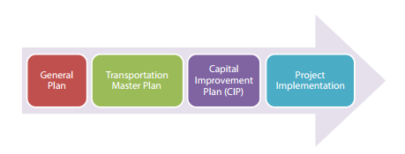



Last time…
YOU can influence the authority that enables the decisions that shape plans for the built environment, and impact our health.
Overview
The General Plan is a foundational plan for cities and towns, and is also called a Comprehensive Plan on the County level.
The General Plan has several elements that form other Master Plans; the processes are similar.
Webinar 2
How to Become a Change Agent
Zoning is a subset process of the Land Use element, and is important in applying the plan to the built environment.
In the planning process there are four areas you can get involved in: Providing information, scoping goals, participating in adoption, and making amendments.
You can find the legal authority and requirements of the General Plan in the Arizona Revised Statutes
(ARS Title 29, Chapter 4, Article 6 )

Slide 4
Now
Webinar 3
Who Can You Enlist to Help?

Slide 5
Plan implementation priorities are influenced by public input
Before you can know who you can enlist to help, it helps to know where in the implementation process they can get involved

Slide 6




Now that we know about plans,
How do they translate into our built environment?
Transportation
Parks and Open Space
Land Use
Economic Development
Policy

Slide 7
Policy
Guides community decisions about the built environment
Established through adoption of plan
Ie: We want to locate our parks closer to neighborhoods

Slide 8
How does policy translate into our built environment?
Policy
Transportation
Parks and Open Space
Land Use
Economic Development
Capital Improvement Program (CIP)
Zoning

Slide 9
What is the CIP ?
Capital Improvement Program (CIP)
The CIP is a budget that is used to fund capital improvement projects
(not including operational expenses and post-construction costs)

Slide 10
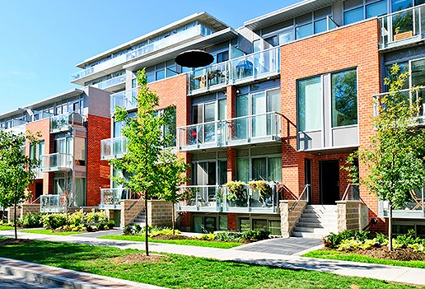
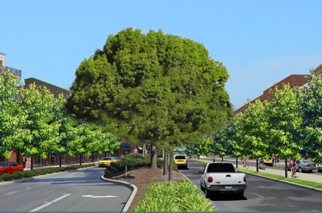
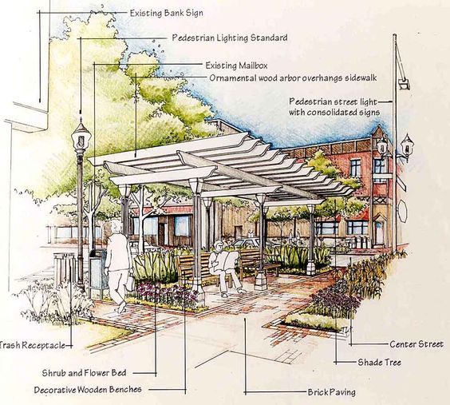
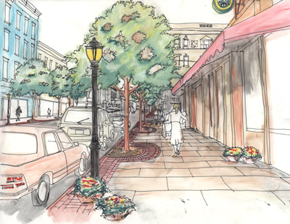
What is a Capital Project?
Capital Project
A capital project is anything that gets built.
Ie: road, swing-set, bike trail, signs, etc.
Notes:
Anything you can see or touch

Slide 11
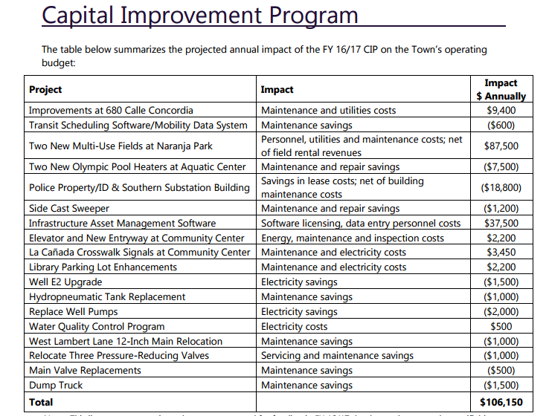
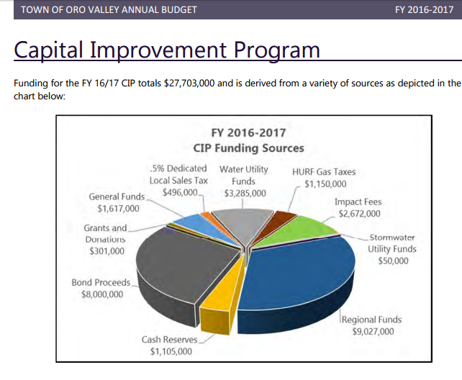
About the CIP
A CIP is a plan that lists specific physical improvements, their cost, and when they will be built
Notes:
https://www.orovalleyaz.gov/sites/default/files/media/docs/2016/adopted-budget-fy16-17.pdf
Maybe add health/community

Slide 12



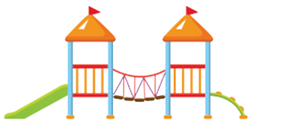

Capital Improvement Program (CIP)
Transportation
Parks and Recreation
Staff
Transportation committee
Parks & Rec Board
The CIP is done internally, so public involvement opportunities are limited—But you can make them!
Notes:
*Insert slide by being an advocate with staff,

Slide 13

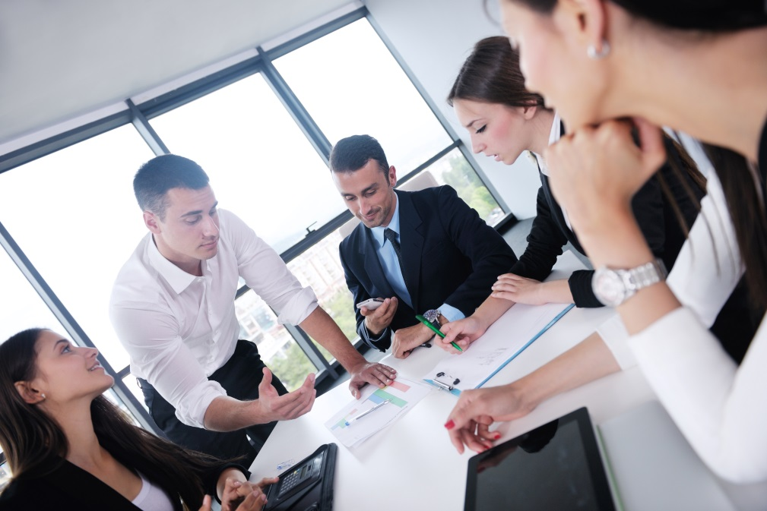
How?
Be an advocate
Talk to staff, boards, and committees
Attend Board & Committee meetings

Slide 14
What funds the CIP?
Bonds, Property Tax, Sales Tax, General Fund, Development Impact Fees
Homeland Security, Tribal gaming, CDBG, Regional Transportation Plan Proposition, USDA Rural
Master Planned Community through dedications of improvements required by zoning
Volunteers, Local Organizations

Slide 15
Remember Zoning?
Zoning
Is a map and ordinance containing codes and regulations of what can be built on each individual parcel

Slide 16
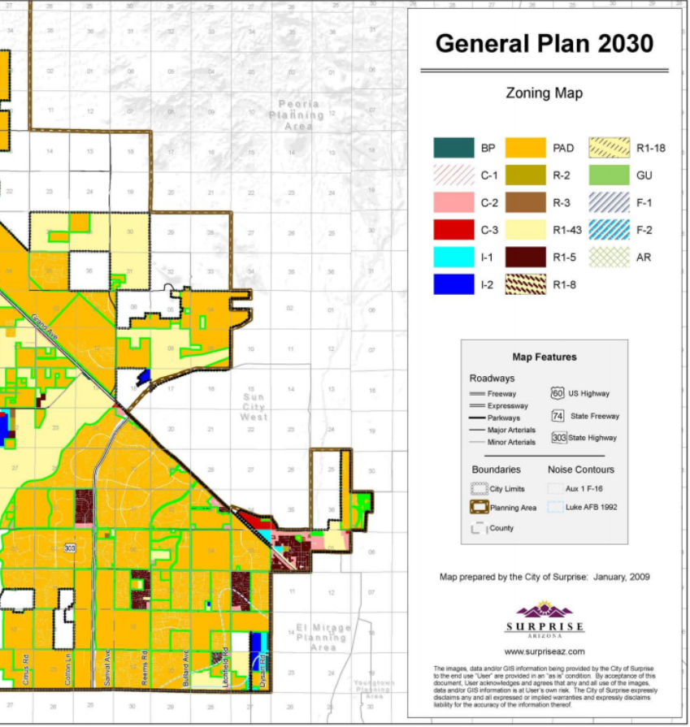
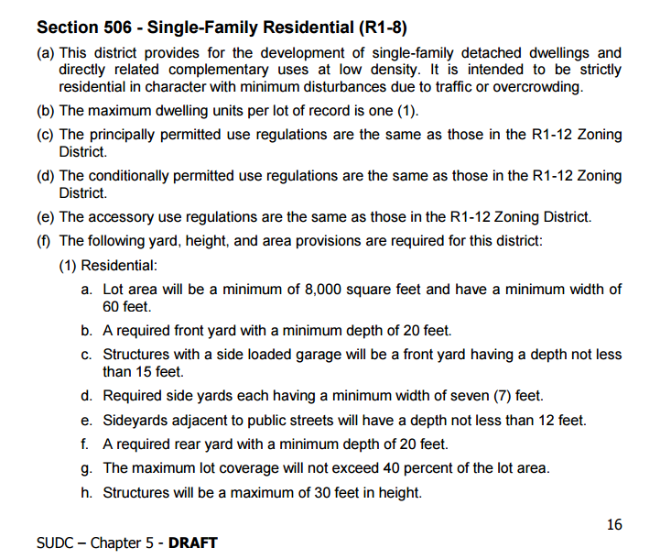
Zoning
Is a map and ordinance containing codes and regulations of what can be built on each individual parcel

Slide 17
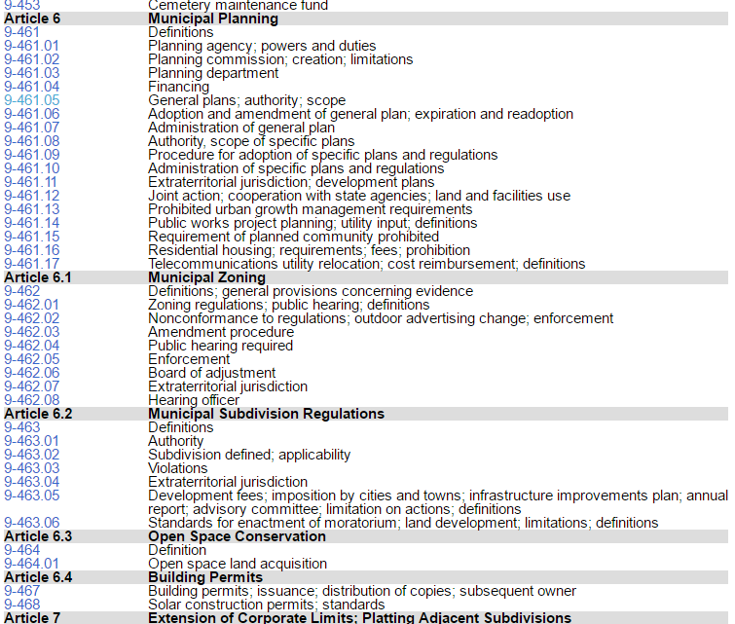
Zoning
The place to check for AZ General Plans for cities is Title 9-Chapter 4, Article 6
Zoning and Subdivision Regulations can be found in 6.1 &6.2
Zoning is a regulatory process mandated by law
Notes:
http://www.flagstaff.az.gov/DocumentCenter/Home/View/8317- state statutes relating to municipalities General Plan

Slide 18
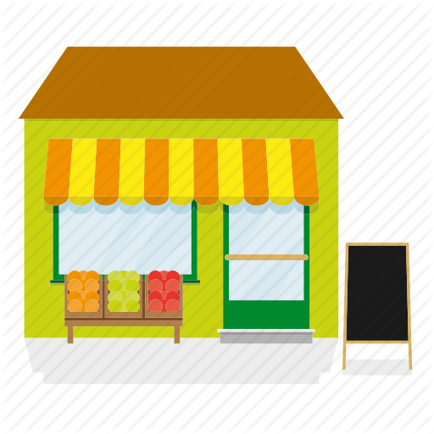
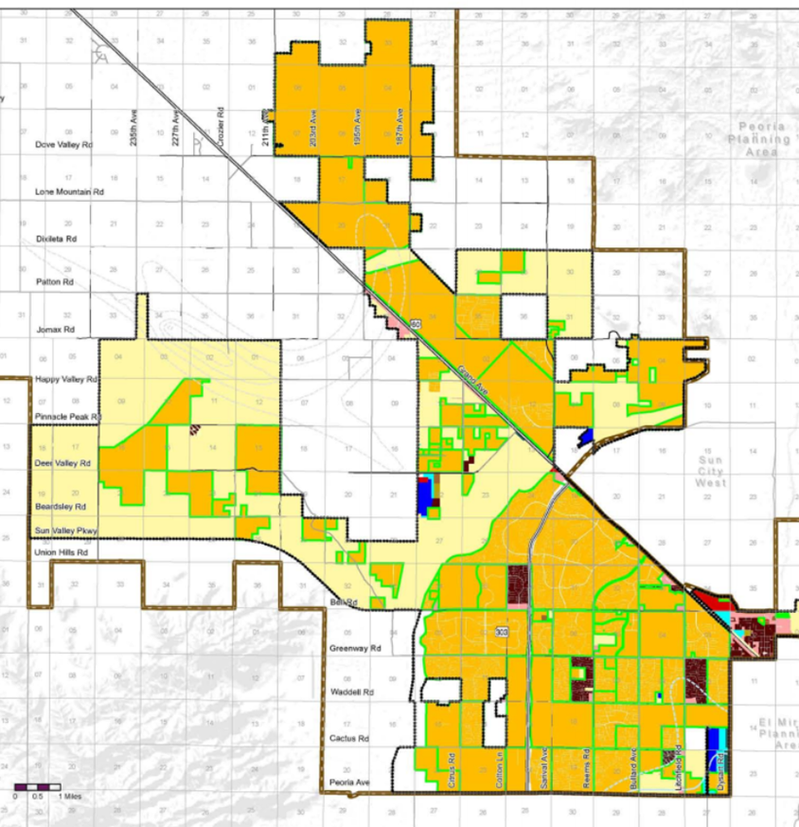


Zoning
General Plan
Zoning Ordinance
Policy/Goals/ Actions
Land Use Regulation
Retail
Supermarkets
Bike Plans
Permitted Uses:
Example policy: Increase Access to Healthy Foods
ZONE: C1-C2
Use permits development of local grocery store
Result: More people can buy fresh produce

Slide 19
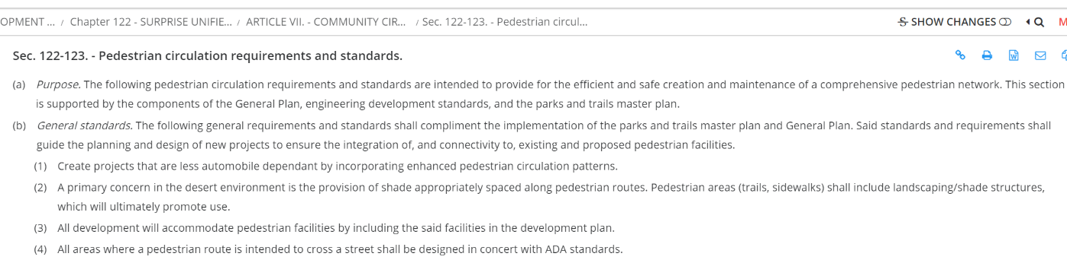
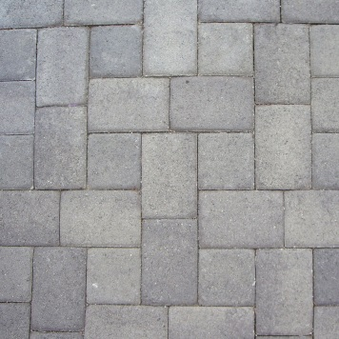
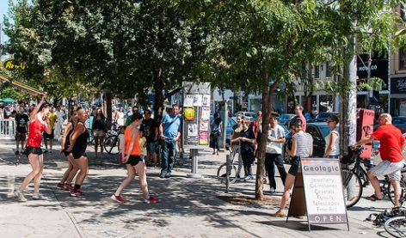
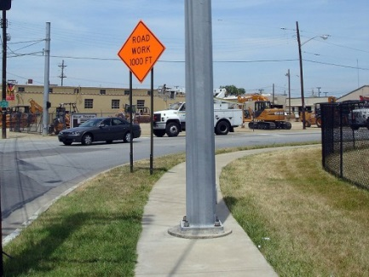
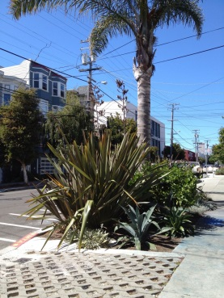
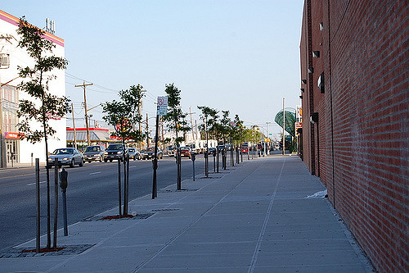
Zoning
Required by Code:
Additional Improvement:
Site Plan requires a sidewalk
Site plan requires pedestrian access to supermarket from sidewalk through the parking lot, permits farmers market in parking lot on Sundays, require bike racks outside markets
Your Healthy Environment Input
But How?
Notes:
Insert zoning code example

Slide 20
We spoke last time of how you can get involved in the GP that influences the zoning ordinance…
Zoning Process
Get Involved
Application
Public Meeting
Planning Commission
City Council
…here is the zoning process
Notes:
We spoke last time of how you can get involved in the General Plan

Slide 21


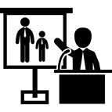

Get Involved
Zoning Process
(Some Cities Differ)
Application
Public Meeting
Planning Commission
City Council
Applicant has1-1 with Planning Liaison to figure out needs
Notification to nearby residents for public hearing and commission meeting
A staff report is drafted and presented to the planning commission
Commission presents to City Council to approve or reject adoption
Notes:
Emphasize health professional

Slide 22
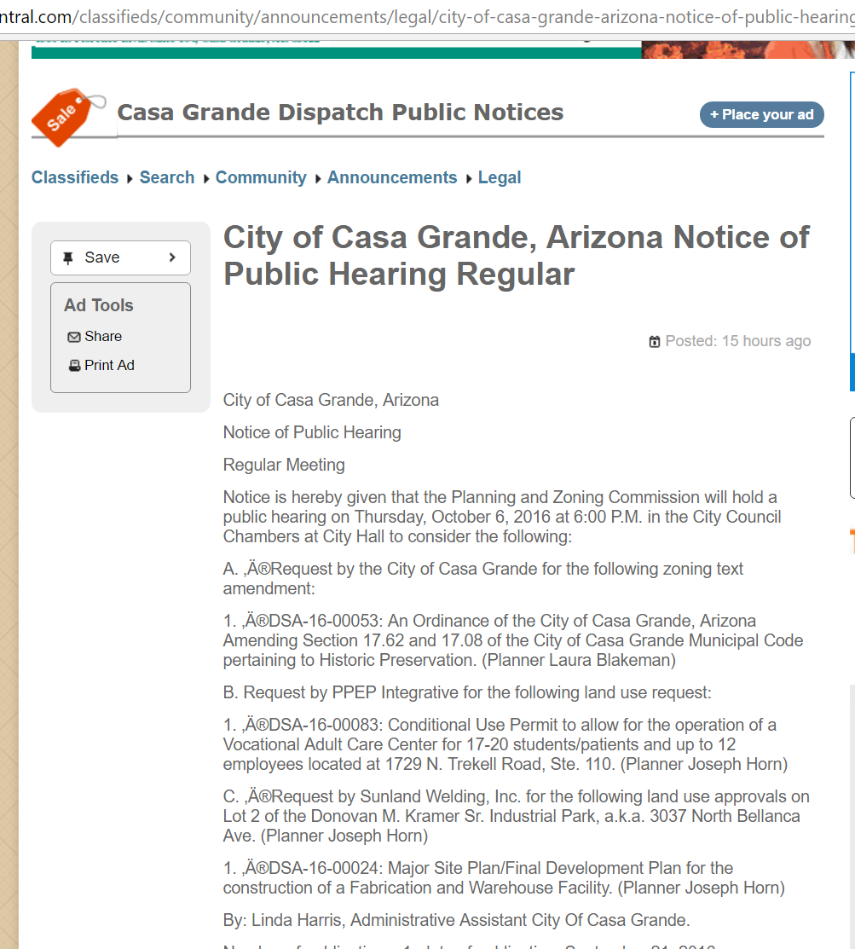
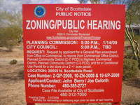
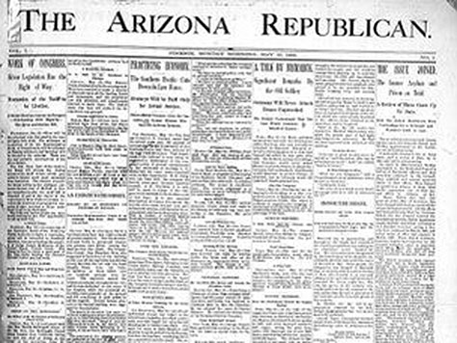
How do I find out if a place will be rezoned?
On-site sign
Newspaper Advertisement
See ARS Legislature for Zoning Requirements

Slide 23
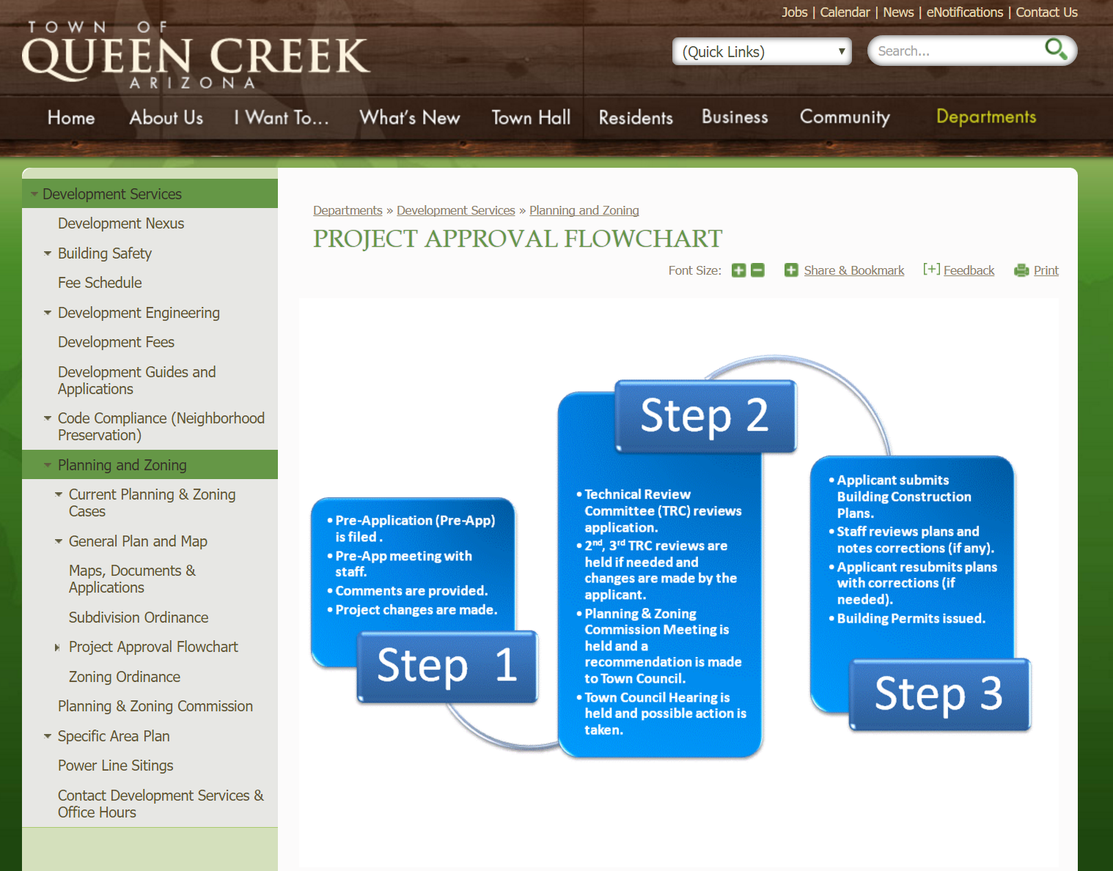

Slide 24
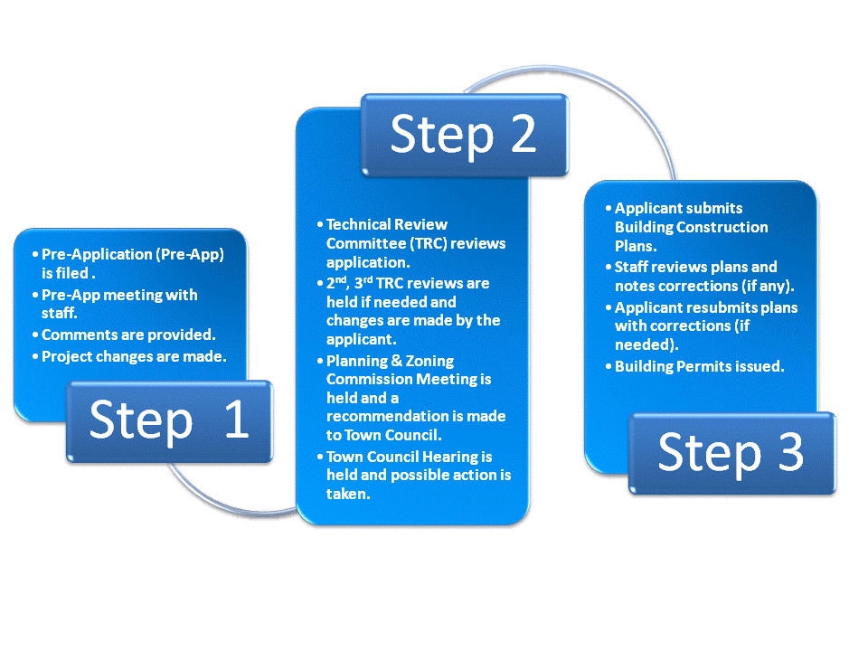
Example: Queen Creek Zoning Process

Slide 25
So Who Can You Enlist to Help?

Slide 26







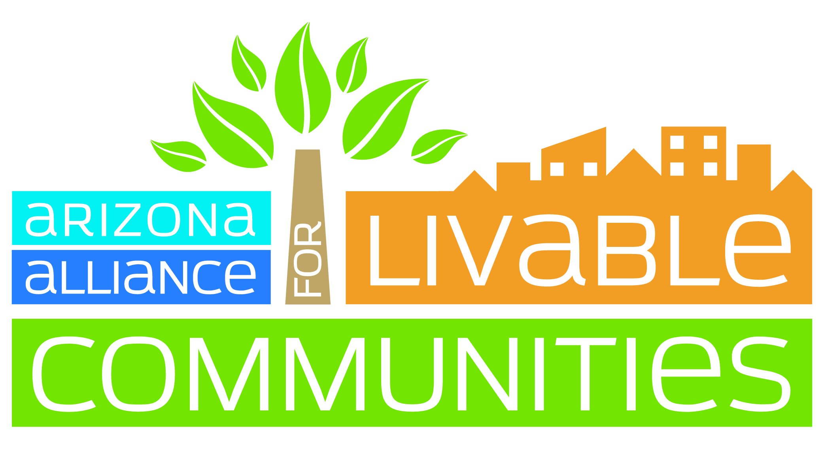





You can enlist the help of other entities that have common interests in projects that benefit community health
Transportation
ULI Chapter
Parks
Planning Chapter
Medical Association
Gym,, Bike Shops/Retail group, AZ Ret. Association,, Health clubs, , , Neighbors, Local s, ,, , , Retailers,
Moms & Me Groups
CoAZ Bicycle
Land Use
Architecture Chapter
AALC
Economic Development
Schools
Hospitals
Merchants
Gyms
There are many more
Notes:
For example, if a project is being built that allows for park enhancements such as lighting and seats, more people can be willing to walk and have easier access routes, so get local organizations involved.

Slide 27
How do I enlist others?
Explain how changes that result in a healthy community are important to them
Think outside health box

Slide 28

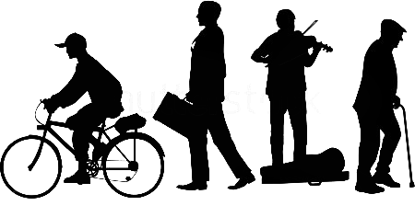
Economic Development
Supporting sidewalks can make people walk more
Health Practitioner
Merchants & Retailers
Interests may differ
Interest: Create healthier communities for people to walk more and thrive
Interest: Support their business through good investment and cost savings
Benefits of pedestrian environment statistics- economic benefits of sustainable streets- Year over year improvements from walkable streets
But why should they care?

Slide 29
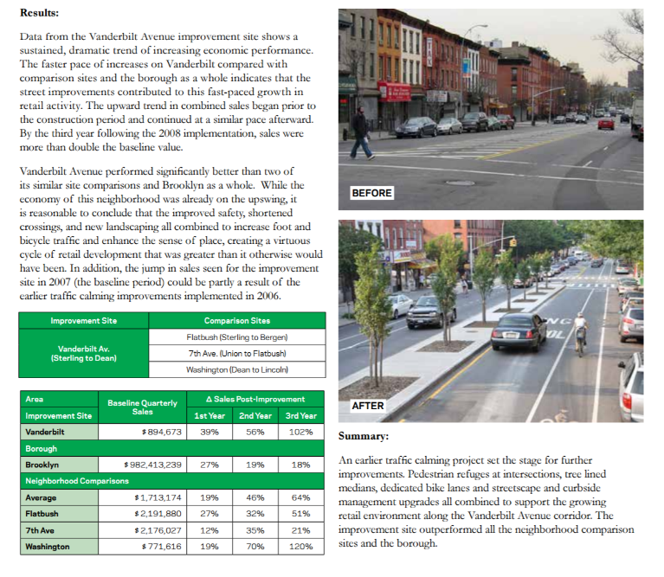
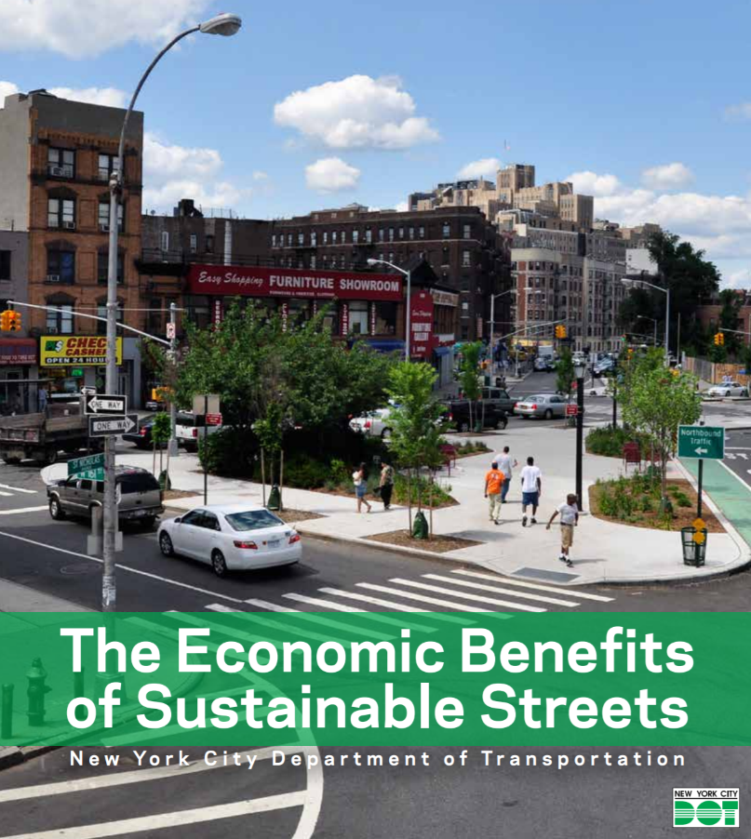
http://www.nyc.gov/html/dot/downloads/pdf/dot-economic-benefits-of-sustainable-streets.pdf

Slide 30
Merchants & retailers can increase sales if they support street improvements for walkable neighborhoods
http://www.nyc.gov/html/dot/downloads/pdf/dot-economic-benefits-of-sustainable-streets.pdf

Slide 31
Economic Development
Health Practitioner
Supporting sidewalks can make people walk more
Merchants & Retailers
Interest: Create healthier communities for people to walk more and thrive
Interest: Support their business through good investment and cost savings
Benefits of pedestrian environment statistics- economic benefits of sustainable streets- Year over year improvements from walkable streets
Outcome: Reduce obesity-related diseases
Outcome: Attract more people to business and have an ethical incentive for customer

Slide 32
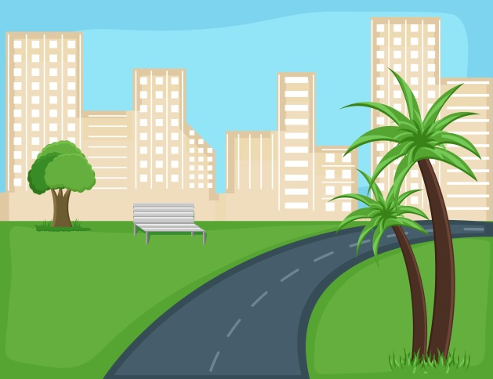
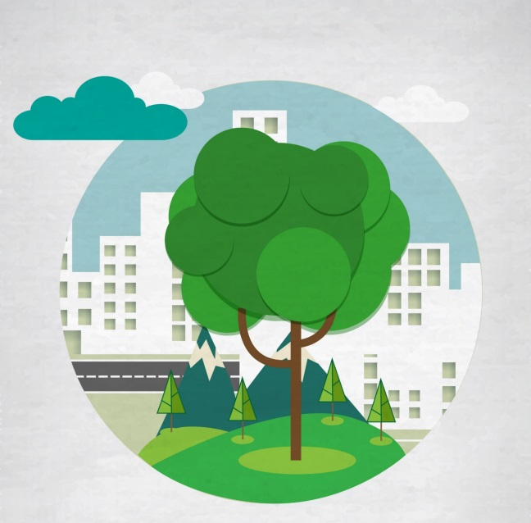
Land Use/Zoning
Parks & Downtown Facilities
Health Practitioner
Developer
ULI – Parks Economic Development / Alliance for Community Trees
Interest: Parks and trails are good for promoting physical activity
Interest: Develop amenities that have high return as a good investment or that are cost savings
+ impact of land values abutting parks area (2001)

Slide 33
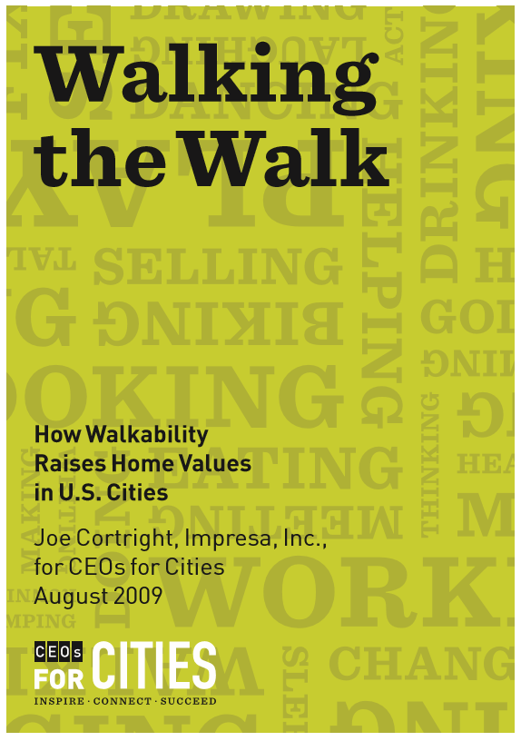
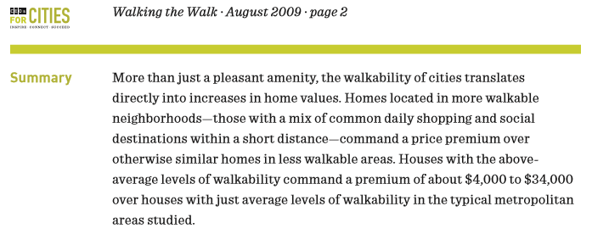

Slide 34
Developers can increase the land value of houses and sell more units

Slide 35

Land Use/Zoning
Health Practitioner
Developer
Parks & Downtown Facilities
ULI – Parks Economic Development / Alliance for Community Trees
Interest: Parks and trails are good for promoting physical activity
Interest: Develop amenities that have high return as a good investment and cost savings
+ impact of land values abutting parks area (2001)
Outcome: Reduce obesity-related diseases
Outcome: More housing units sold

Slide 36
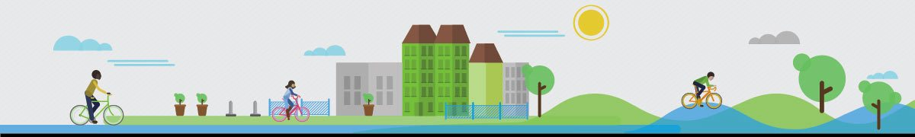
Parks and Recreation
Sidewalks are good for health and business//walkable
Health Practitioner
Cities and Towns
Recreational Facilities
Multimodal bike
Interest: Provide program opportunities and safe spaces for physical activity
Interest: Promote economic development and higher quality of life
Parks & trails which are good for health are
10 best places to live

Slide 37
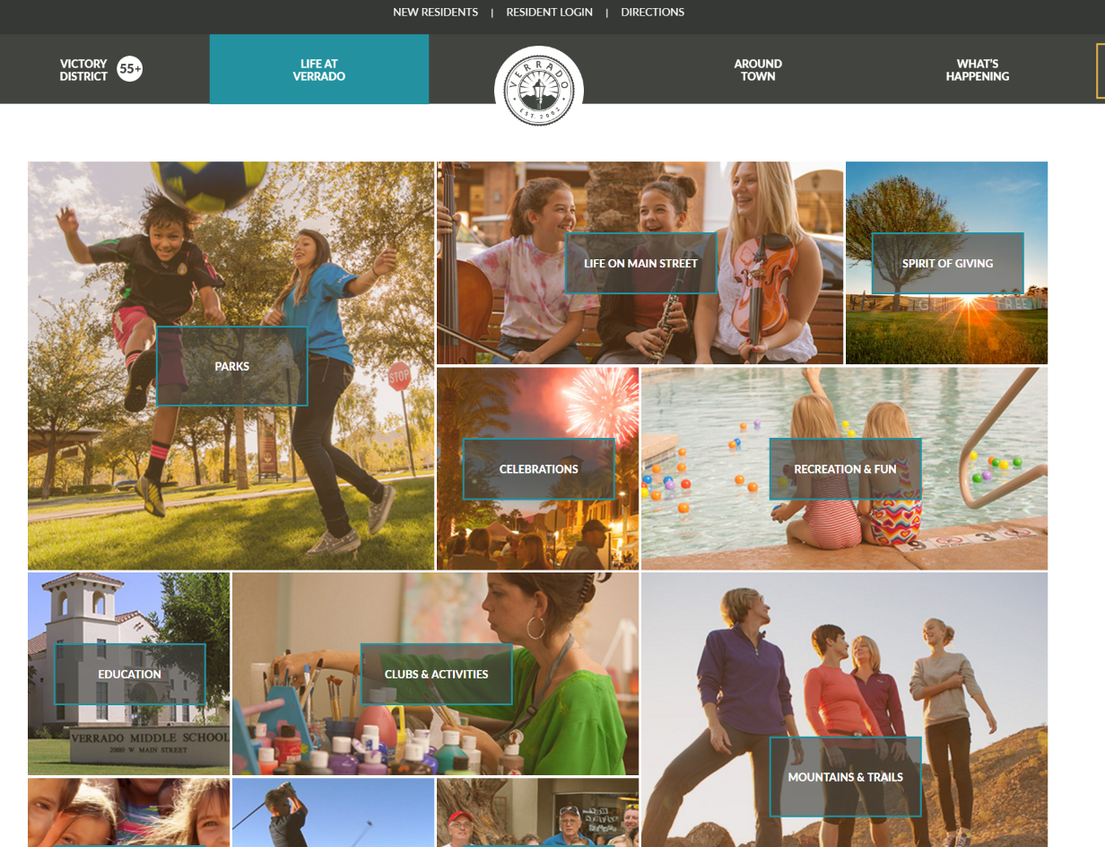
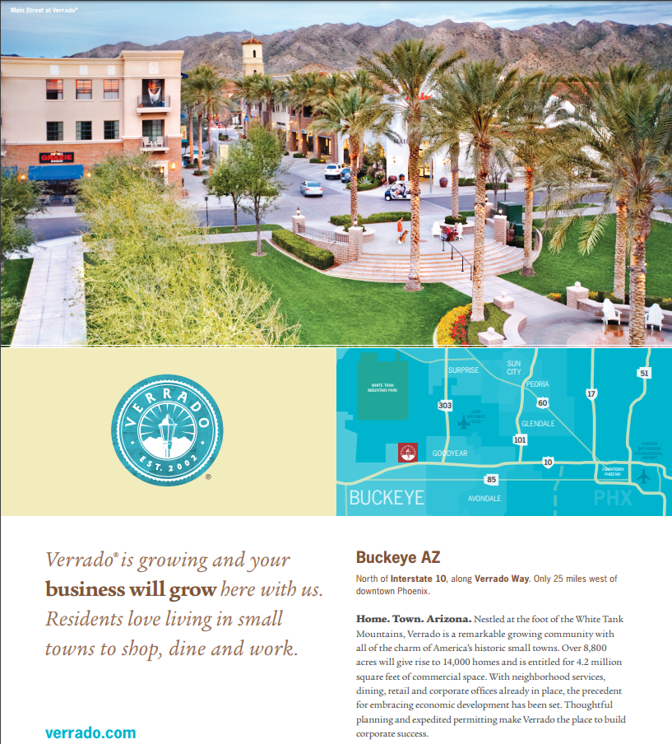
Notes:
Verrado oat a glance highlighting parks / health and wellness

Slide 38
Cities can highlight parks and health & wellness as attractions for their town
Notes:
Verrado oat a glance highlighting parks / health and wellness

Slide 39
Parks and Recreation
Sidewalks are good for health and business//walkable
Health Practitioner
Cities and Towns
Recreational Facilities
Multimodal bike
Interest: Provide program opportunities and safe spaces for physical activity
Interest: Promote economic development and higher quality of life
Parks & trails which are good for health are
10 best places to live
Outcome: Reduce obesity-related diseases
Outcome: Increase Tax Base

Slide 40



Transportation
Health Practitioner
Roadway Facilities
Department of Transportation
Interest: Provide multimodal opportunities
Interest: Provide infrastructure for efficient mobility
Bike lanes reduce congestion
Shaded sidewalks reduce accidents
Transit more ppl using bike/walking to travel.
Notes:
http://uli.org/wp-content/uploads/ULI-Documents/America-in-2015.pdf

Slide 41
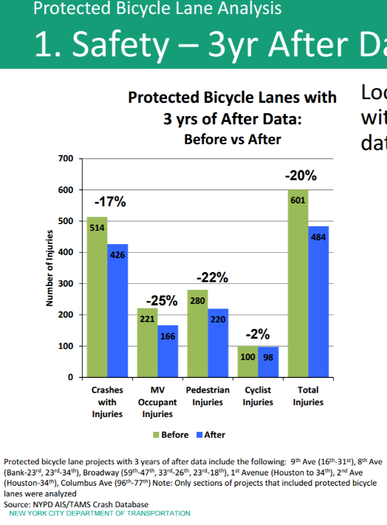
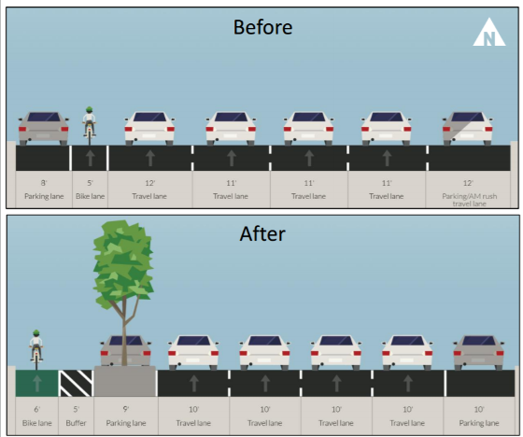
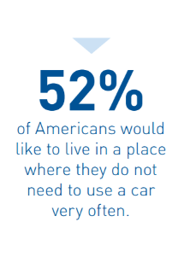
Bike lanes reduce injuries
Bike lanes reduce congestion
-35% travel time (4.5 min vs. 3min)
More people prefer to bike or walk to work
ULI-America in 2015
Notes:
Verrado oat a glance highlighting parks / health and wellness
http://www.citylab.com/cityfixer/2014/09/when-adding-bike-lanes-actually-reduces-traffic-delays/379623/
http://www.nyc.gov/html/dot/downloads/pdf/2014-09-03-bicycle-path-data-analysis.pdf

Slide 42
Transportation
Health Practitioner
Roadway Facilities
Department of Transportation
Interest: Provide multimodal opportunities
Interest: Provide infrastructure for efficient mobility
Bike lanes reduce congestion
Shaded sidewalks reduce accidents
Outcome: Reduce obesity-related diseases with physical activities
Outcome: Reduce congestion and improve safety
Transit more ppl using bike/walking to travel.
Notes:
http://uli.org/wp-content/uploads/ULI-Documents/America-in-2015.pdf

Slide 43
Players in the Approval Process
Staff/City Council
Property Owner/Planner/Council
Merchants/ Development Review Board

Slide 44
Overview
Policy guides the community goals established through adoption of a plan that shapes the built environment
Policy
A CIP is a budget that is used to fund capital improvement projects (not including operational expenses and costs)
Transportation
Parks and Open Space
Land Use
Economic Development
Zoning is a map and ordinance containing codes and regulations on what can be built on each individual parcel
Capital Improvement Program (CIP)
Zoning
Gather interested entities to find a common development that can promote health. Be created and think outside the health box to address their interests and why they should be involved.

Slide 45
Questions?

Slide 46

Thank You!

