Slide 1
What Creates Our Built Environment?
WEBINAR 1
Notes:
Stock images retrieved from:
http://www.luxus-india.com/modular-kitchen-design-offer/stock-vector-flat-city-icon-209365492/
https://www.pinterest.com/pin/330099847661573060/

Slide 2
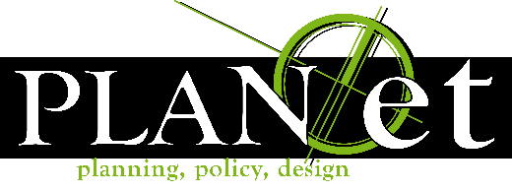
BROUGHT TO YOU BY:
Arizona Nutrition Network
PLAN*et

Slide 3
Moderators:
Agenda Items
Stephanie Martinez
Ryan Lang
Leslie Dornfeld
Christiane Quintans
5 Min. Introduction
Webinar 1 – 40m
Q&A- 20 min
Posted Online

Slide 4
Moderators:
Agenda Items
Stephanie Martinez
Webinar 1
Leslie Dornfeld
What Creates Our Built Environment?
Christiane Quintans
5 Min. Introduction
Webinar 1 – 40m
Q&A- 20 min
Posted Online

Slide 5
Moderators:
Agenda Items
Stephanie Martinez
Webinar 1
Leslie Dornfeld
What Creates Our Built Environment?
Christiane Quintans
Webinar 2
How to Become a Change Agent for Healthier Environments
5 Min. Introduction
Webinar 1 – 40m
Q&A- 20 min
Posted Online

Slide 6
Moderators:
Agenda Items
Stephanie Martinez
Webinar 1
Leslie Dornfeld
What Creates Our Built Environment?
Christiane Quintans
Webinar 2
How to Become a Change Agent for Healthier Environments
5 Min. Introduction
Webinar 1 – 40m
Q&A- 20 min
Posted Online
Webinar 3
Who Can You Enlist to Help?

Slide 7
What Creates Our Built Environment?
WEBINAR 1
Notes:
We’ll be looking at what affects both us directly and the surrounding community through the built environment , how that impacts our health through physical activity in our daily lives, & lastly what creates the built environment.

Slide 8
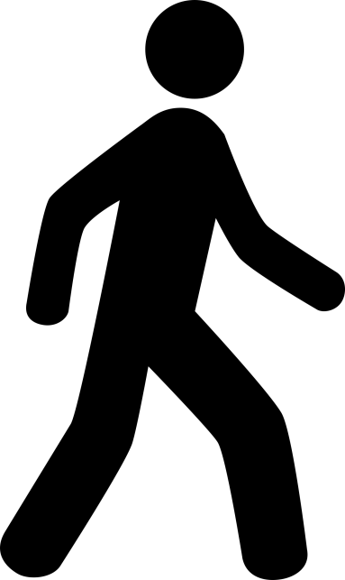
What is our Built Environment?

Slide 9
What is our Built Environment?
Let’s take a look!

Slide 10
What is our Built Environment?
How we travel
What we do
Where we live
Transportation
Infrastructure
Parks, Open Spaces & Trails
Community Design & Land Use
Notes:
Let’s take a look at how we move around our cities & travel, the things that we do; and where we live in the community.

Slide 11
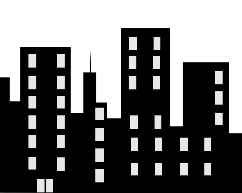
Transportation is what we use to travel

Slide 12
Roads for buses and transit

Slide 13
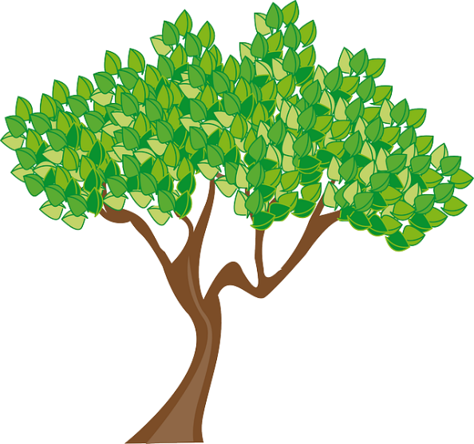
Sidewalks and crosswalks

Slide 14
Bike lanes and paths

Slide 15
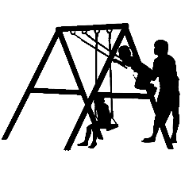
Parks, open spaces & trails, are where we relax & play

Slide 16
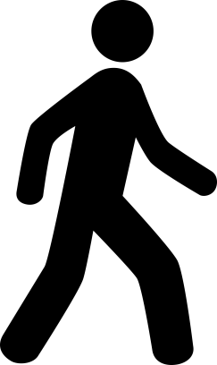
Land use and design is buildings, how they are used, and how they are organized to create a community

Slide 17
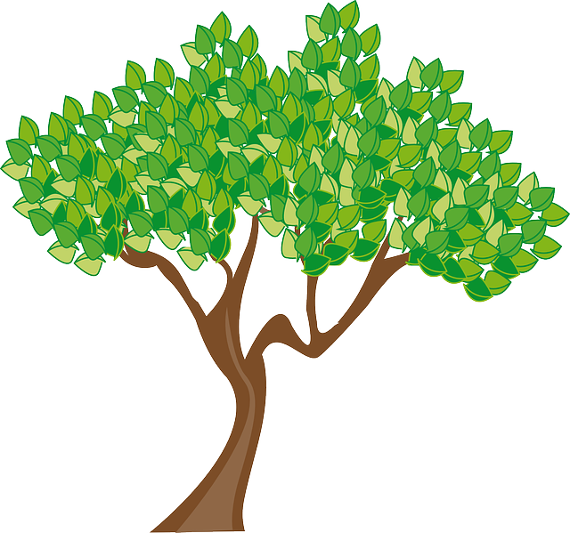
Where we live, work, and shop

Slide 18
Our built environment also includes what is not here

Slide 19
What’s missing?

Slide 20
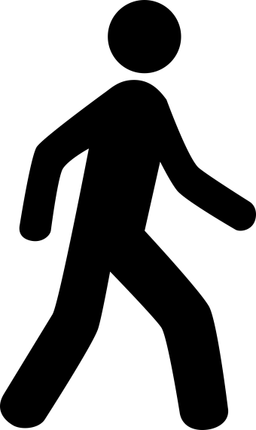
What’s missing?

Slide 21
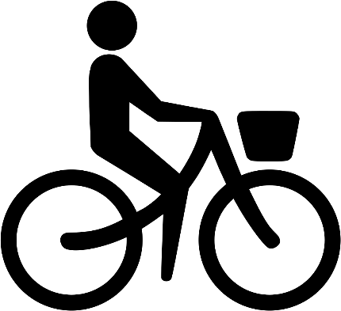
What’s missing?

Slide 22
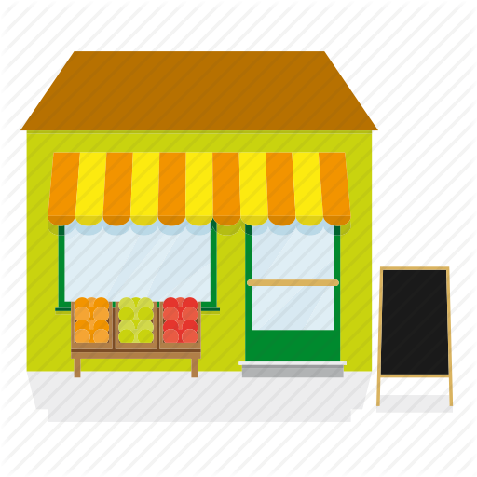
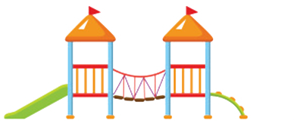
What’s missing?

Slide 23
Why is our Built Environment Important?

Slide 24
Our built environment affects our health
10%
60%
20-30%

Slide 25
Why is our Built Environment Important to Health?
Why is our Built Environment Important?
10%
60%
20-30%

Slide 26
Why is our Built Environment Important to Health?
Why is our Built Environment Important?
10%
60%
20-30%

Slide 27
Why is our Built Environment Important to Health?
Why is our Built Environment Important?
60%
20-30%

Slide 28
Why is our Built Environment Important to Health?
Why is our Built Environment Important?
60%

Slide 29
How does the built environment affect health?

Slide 30
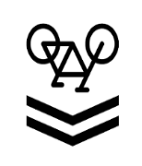
We can be healthier if we do this
Notes:
Choices in how we travel

Slide 31
Instead of this

Slide 32
We can be healthier if we do this

Slide 33
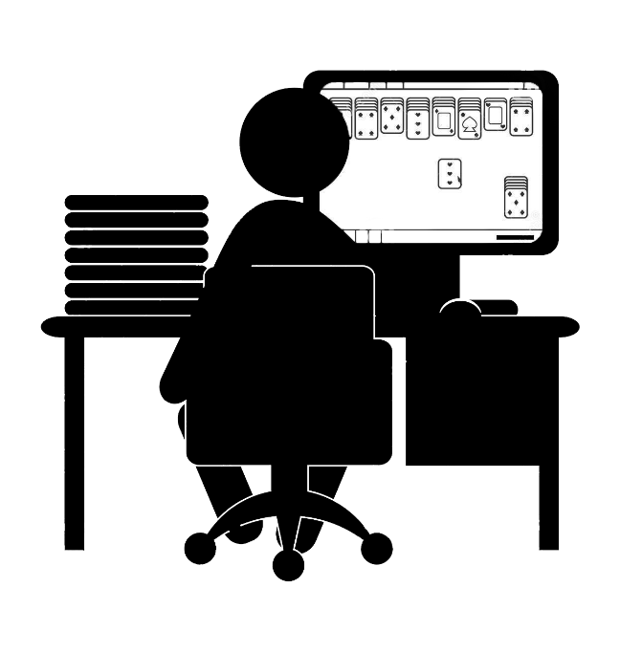
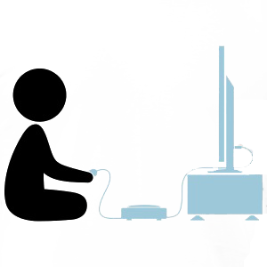
Instead of this

Slide 34
We can be healthier if we do this

Slide 35
Instead of this
STORES

Slide 36
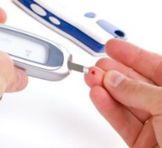
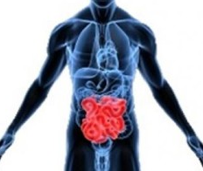
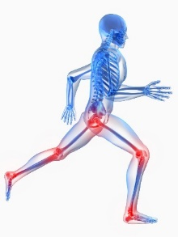
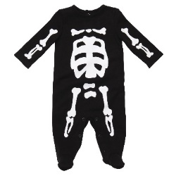
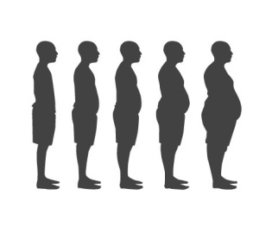
How does the built environment affect health?
Physical Activity
Lowers risk of cardiovascular disease, colon cancer, & diabetes
Relieves depression, anxiety, &other mental illnesses
Maintains muscle strength & joint structure/function
Necessary for normal skeletal development during childhood
Along with appropriate dietary patterns, lowers obesity
Notes:
*transportation, recreation, & neighborhood design have the most direct impact on physical activity

Slide 37
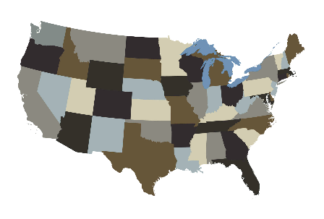
In the US….
In Arizona…
25% not active at all
28.9%
50% are not sufficiently physically active
14.9%
10.6%
1990
2000
2014
Source: Trust for America's Health and Robert Wood Johnson Foundation. The State of Obesity 2015 [PDF]. Washington, D.C.: 2015
~ 60% of the US population are overweight or obese
29th highest adult obesity rate in the nation
An immediate cause of physical inactivity is sedentary habits—some unavoidable in automobile-oriented communities
*Rural Counties have higher obesity rates & other obesity-related diseases*
http://stateofobesity.org/physical-inactivity/
https://www.ruralhealthinfo.org/topics/obesity-and-weight-control
Notes:
29th highest The State of Obesity: Better Policies for a Healthier America. -http://stateofobesity.org/states/az/
Physical inactivity remains widespread despite governmental and non-profit efforts to promote behavioral change– and despite the continued rise of the fitness industry.. In the US, ^ 50% of adults are not sufficiently physically active, and 25% are not active at all. Recent data show a rapid rise in the proportion of overweight or obese people (now estimated at more than 60% of the US population ; physical inactivity and overweight or obesity are directly associated with epidemic levels of chronic diseases (including diabetes and arthritis), stroke, mental illness, and some forms of cancer. ;Immediate cause of physical inactivity is sedentary, some are unavoidable in many cities planned for the automobile.-P 134 Local Planning: Contemporary Principles & Practice ICMA- Gary Hack, Eugenie L. Birch, Paul H. Sedway, & Mitchell J. Silver
Rural counties have higher obesity rates & other obesity-related diseases- https://www.ruralhealthinfo.org/topics/obesity-and-weight-control
Adult Obesity Rate in Arizona (1990-2014)- Trust for America's Health and Robert Wood Johnson Foundation. The State of Obesity 2015 [PDF]. Washington, D.C.: 2015

Slide 38
How does the built environment affect health?
Let’s Take Another Look…

Slide 39
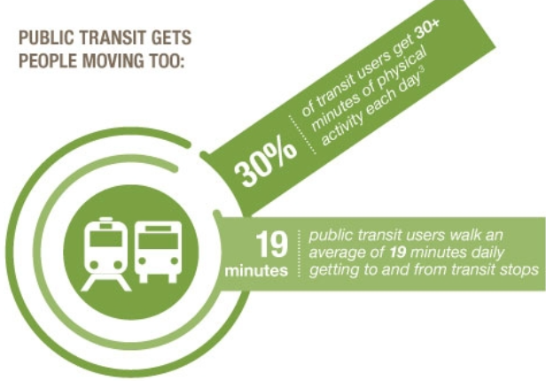
Transportation
Diverse modes of transit can allow more physical engagement for regular trips
*Robert Woods Foundation
*PeopleForBikes
Notes:
You don’t have to give up your car, but you do need to have options.

Slide 40
Transportation
*Robert Woods Foundation

Slide 41
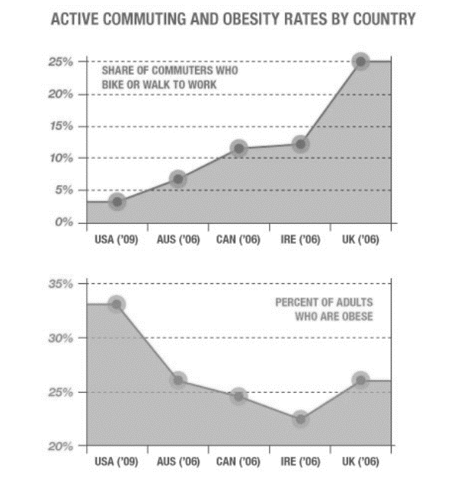
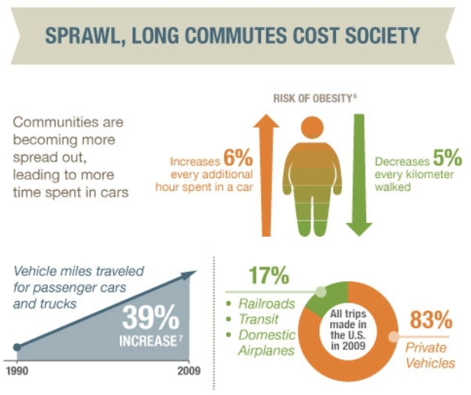
Transportation
Reduces auto-dependency and promotes physical activity
*Robert Woods Foundation

Slide 42
Transportation
Reduces auto-dependency and promotes physical activity
*Robert Woods Foundation

Slide 43
Transportation
Reduces auto-dependency and promotes physical activity
*Robert Woods Foundation

Slide 44
Transportation
Reduces auto-dependency and promotes physical activity
*Robert Woods Foundation

Slide 45
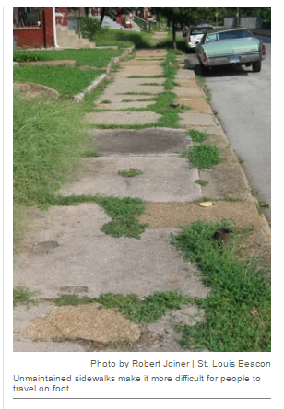
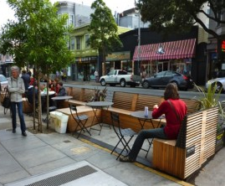
Streets & Sidewalks
Streets and sidewalks take up 25-50 % of a typical U.S. city’s land
*PeopleForBikes
Poor sidewalks (or lack-of) can deter people from engaging in an inexpensive way to exercise
Sidewalks help provide access to disabled and elderly
*PeopleForBikes
People are more inclined to walk with inviting streets and sidewalks made for pedestrians vs. automobiles
Notes:
“Although walking is viewed as an inexpensive way to exercise, it turned out to be much harder to do in black neighborhoods because their built environments did not support walking for recreation or transportation.” --https://www.stlbeacon.org/#!/content/17667/city_parks_and_sidewalks_play_a_role_in_health_disparities
Like many other public-health experts, Kelly says broken-down park equipment and poorly maintained sidewalks give residents an excuse not to use them for exercise. That in turn could mean people are getting less physical activity in general, which Kelly says is a factor associated with health disparities, such as obesity and some chronic diseases and conditions.
Ways that sidewalks can help bike safety -http://brokensidewalk.com/2016/anatomy-protected-bike-lane/

Slide 46
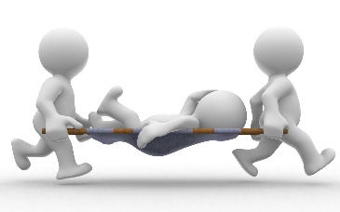
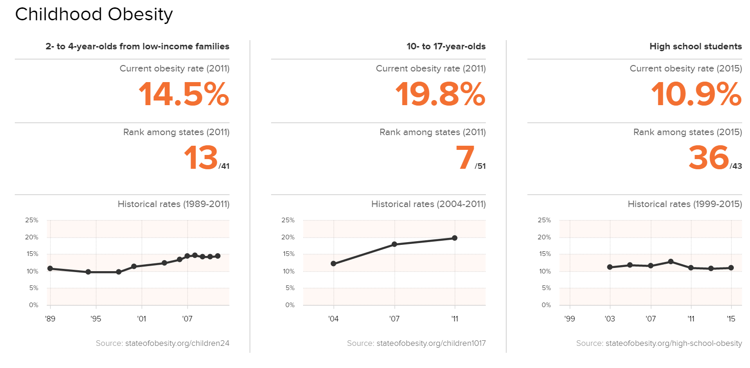
Safe-Routes-to-School
Providing kids safe ways to travel to school aside from cars can reduce childhood obesity.
Streets & Sidewalks
in Arizona
Notes:
http://mobilitylab.org/2015/07/09/streets-and-sidewalks-should-be-used-to-improve-our-health/
Safety is also another important issue.
Built design could prevent injury accidents and fatalities. For example, to support pedestrian activity (and promote physical activity) you can have narrower streets that reduce vehicle speed and give wider space for walkable activities.

Slide 47
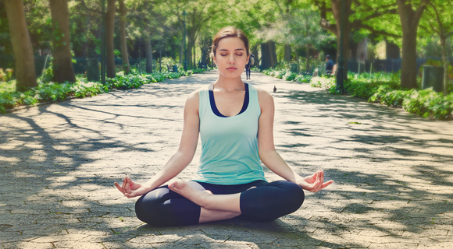
Parks & Trails
Provides activities to alleviate stress and build cardio
Parks can provide infrastructure to support community gardens, sports courts, and open space for passive meditating activities like yoga.
Notes:
http://brokensidewalk.com/2016/anatomy-protected-bike-lane/
Exposure to nature may lead to decreased levels of stress, greater job satisfaction, and faster recovery from fatigue
(Kaplan and Kaplan 1989; Ulrich 1984; Ulrich et al. 1991; Maller et al. 2005)

Slide 48
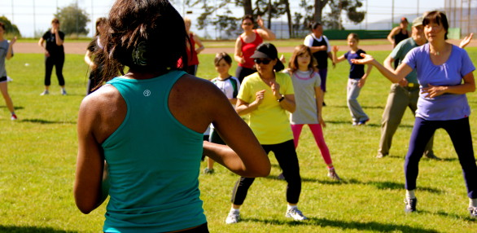
Parks & Trails
Provides activities to alleviate stress and build cardio
Parks can provide infrastructure to support community gardens, sports courts, and open space for passive meditating activities like yoga.
Provides safe place to exercise and play
In a 2005 report, the US Department of Health and Human Services demonstrated that a lack of built environment appropriate for safe physical activity increases risk of obesity and type 2 diabetes
Notes:
http://brokensidewalk.com/2016/anatomy-protected-bike-lane/
Exposure to nature may lead to decreased levels of stress, greater job satisfaction, and faster recovery from fatigue
(Kaplan and Kaplan 1989; Ulrich 1984; Ulrich et al. 1991; Maller et al. 2005)

Slide 49
Parks & Trails
Provides activities to alleviate stress and build cardio
Parks can provide infrastructure to support community gardens, sports courts, and open space for passive meditating activities like yoga.
Provides safe place to exercise and play
In a 2005 report, the US Department of Health and Human Services demonstrated that a lack of built environment appropriate for safe physical activity increases risk of obesity and type 2 diabetes
People who live closer to a park are more likely to walk to and use the park.
Exposure to nature may lead to decreased levels of stress, greater job satisfaction, and faster recovery from fatigue
(Kaplan and Kaplan 1989; Ulrich 1984; Ulrich et al. 1991; Maller et al. 2005)
*PeopleForBikes
Notes:
http://brokensidewalk.com/2016/anatomy-protected-bike-lane/
Exposure to nature may lead to decreased levels of stress, greater job satisfaction, and faster recovery from fatigue
(Kaplan and Kaplan 1989; Ulrich 1984; Ulrich et al. 1991; Maller et al. 2005)

Slide 50
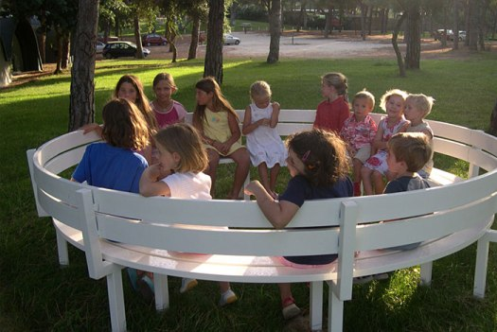
Communities
Sense of community can aid depression and isolation
Thinking of health in neighborhood design can promote walkable activities,& allow for interactions to create and strengthen social bonds
An HIA in Denver Housing Authority allowed for redesign of public housing to allow for buildings with day lighted stairwells, pedestrian and bicycle links to nearby parks and transit stations, outdoor play areas for children, indoor bike storage, and bicycle repair stations.
People who live in neighborhoods with parks, trails, and greenways are 2x as healthy as people who live in neighborhoods without such facilities.
-American Journal of Preventive Medicine
*PeopleForBikes
Notes:
Graphics- http://brokensidewalk.com/2016/anatomy-protected-bike-lane/
Resources:
https://health.ucsd.edu/news/releases/Pages/2016-04-01-study-finds-neighborhood-design-helps-health.aspx
http://urbanland.uli.org/economy-markets-trends/healthy-communities-a-new-direction-in-development/
http://activelivingresearch.org/neighborhood-design-and-health-characteristics-built-environment-and-health-related-outcomes
Sense of Community : https://www.sciencedaily.com/releases/1999/08/990810164724.htm

Slide 51
How did these get there?
Sidewalks and street
Housing
Transportation
Infrastructure
Parks and trails

Slide 52
How did these get there?
Sidewalks and street
Housing
Transportation
Infrastructure
Parks and trails

Slide 53
How did these get there?
PLANS!

Slide 54
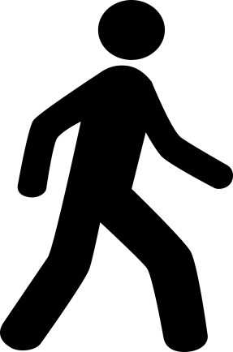
Who Makes These Plans?

Slide 55
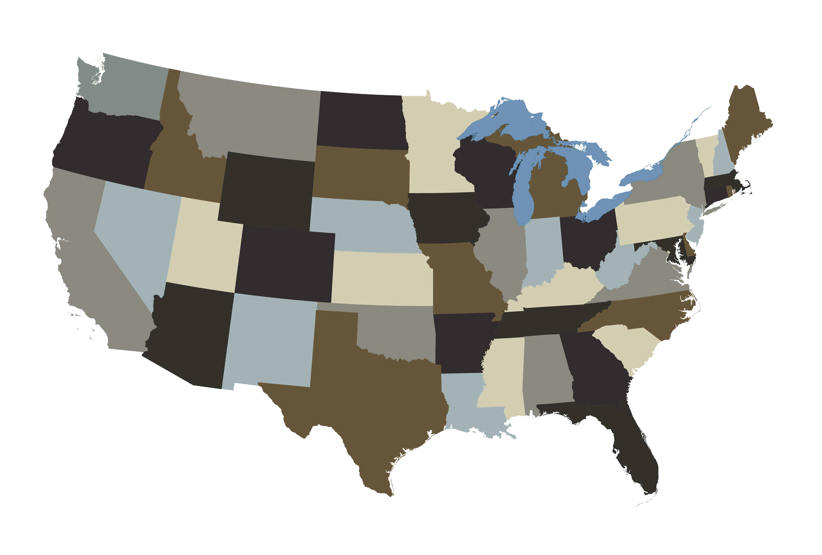
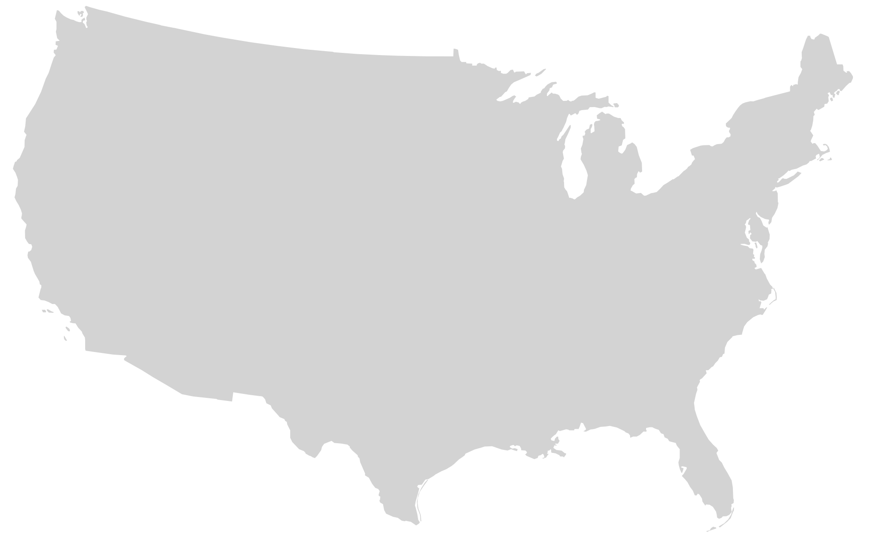
Federal
United States

Slide 56
State
Arizona

Slide 57
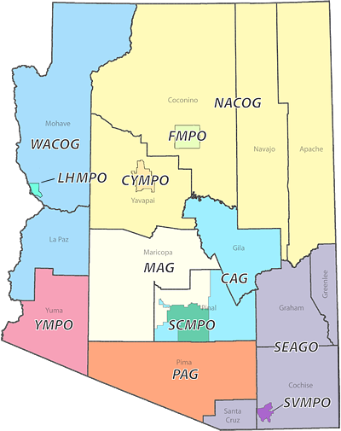
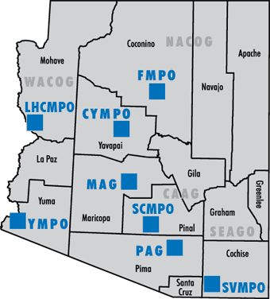
*Regional
https://www.azmag.gov/archive/AZ-COGs/index.asp
COGs
MPOs
Council of Governments
Metropolitan Planning Organizations
Intercounty partnerships
Fed. Recognized urban areas (pop. 50,000+)

Slide 58
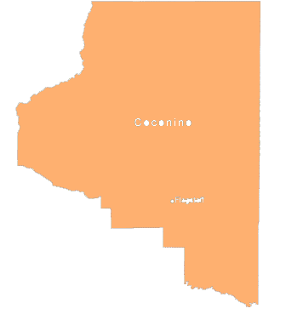
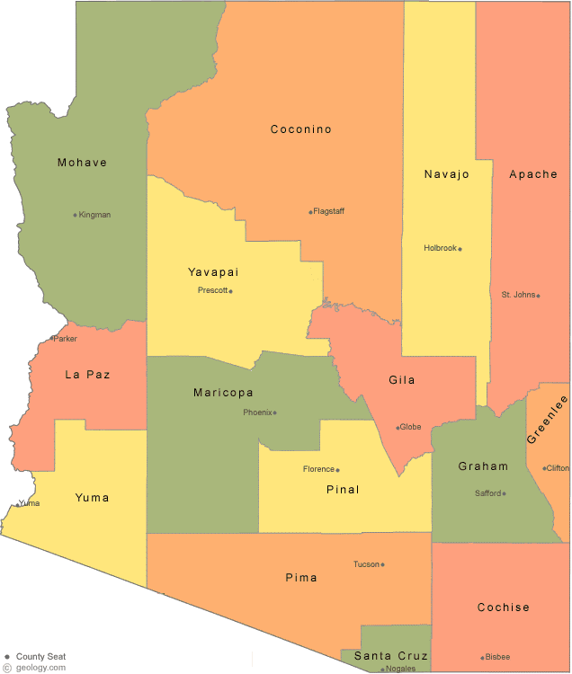
County
Coconino

Slide 59
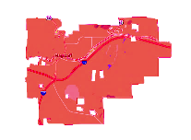
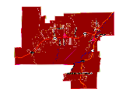
Municipal
Cities and Towns

Slide 60
Municipal
(Towns)
Fredonia
Flagstaff
Sedona
(Cities)
*Note: Some cities can be classified in different counties, like Sedona.
Yavapai

Slide 61
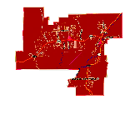
Neighborhoods
Sedona
Cities and Towns

Slide 62
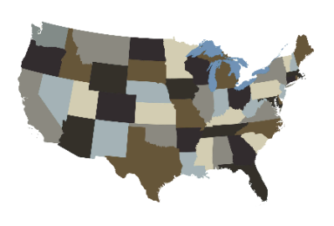
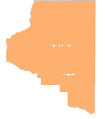
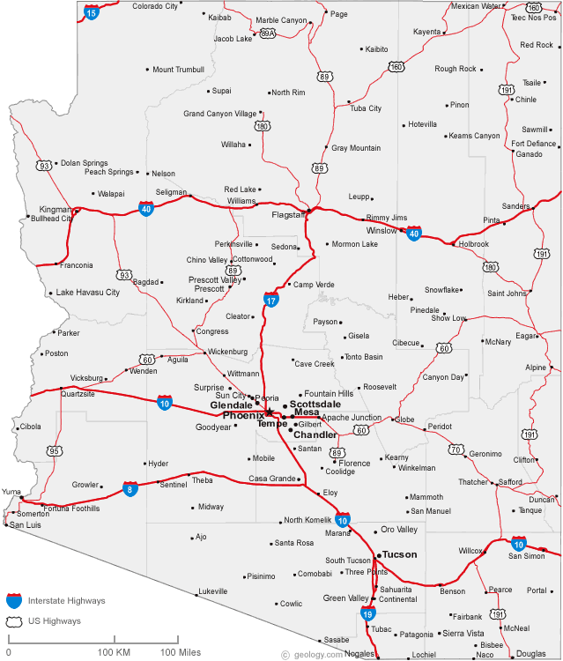
Powers
Federal
United States
Creates Broad Policies & Funding
State
Designates Mandates & Oversees Policies
Arizona
County
16 Counties
Municipal
LOCAL
91+ Counties
Most plans are implemented and affected
Neighborhood
City/Town Individual
Notes:
https://www.azmag.gov/archive/AZ-COGs/Arizona_MPOs/pg_azMPOs.asp

Slide 63
Plan Categories
Land Use
Economic Development
FEDERAL
Parks and Open Space
STATE
COUNTY
Transportation
LOCAL
Notes:
Federal Policy requires (like a national plan) states to address certain plans

Slide 64
Plan Categories
Land Use
Economic Development
FEDERAL
Parks and Open Space
STATE
COUNTY
Transportation
LOCAL
All Levels
Notes:
Plans are done at different levels, some categories like transportation are done at all levels.

Slide 65
Plan Categories
Land Use
Economic Development
FEDERAL
Parks and Open Space
STATE
COUNTY
Transportation
LOCAL
County & Local
Notes:
Some like land use are done only at the county and local levels.

Slide 66
Plan Categories
Land Use
Economic Development
It depends what plan…
FEDERAL
Parks and Open Space
STATE
COUNTY
Transportation
LOCAL

Slide 67
Transportation
Parks and Open Space
Economic Development
Land Use
Transportation
Parks & Open Space
Economic Development
Land Use
Transportation Master Plan
Planning Assistance for Rural Areas (PARAs)
Bike, Pedestrian, & Sidewalk
Corridor Plan
Comprehensive Plan
General Plan
Corridor Plan
Neighborhood Plan
Park Master Plan
Planned Area Developments (PADs)
Downtown Plans
Strategic

Slide 68
Transportation
Parks and Open Space
Land Use
Economic Development
Transportation Plans are developed at all levels of government:
Transportation Master Plan
Planning Assistance for Rural Areas (PARAs)
Bike, Pedestrian, & Sidewalk
Corridor Plan
Neighborhood
Municipal
County
Regional
State
Federal
Notes:
Some plans are done at all different levels

Slide 69
Transportation
Federal
Federal Highway Association (FHWA) & Federal Transit Authorities (FTA)
United States
State
Arizona Department of Transportation (ADOT)
*Regional Transportation
MPO & COGs
Arizona
(County) Department of Transportation/ Transit Authority
County
https://www.azmag.gov/archive/AZ-COGs/Arizona_MPOs/pg_azMPOs.asp
16 Counties
Municipal
(City/Town) Department of Transportation Development
91+ City/Town
Neighborhood
HOA’s & Neighborhood Watch
Community Individuals
Notes:
These are the different bodies that can be involved in transportation. From the federal body to the neighborhood level.

Slide 70
Federal Transportation Plan
Federal
Neighborhood
Municipal
County
Regional
State
Federal
Notes:
Here’s an example of federal level plan

Slide 71
Federal Transportation Plan
Federal
https://www.transportation.gov/sites/dot.gov/files/docs/2014-2018-strategic-plan_0.pdf
Neighborhood
Municipal
County
Regional
State
Federal
Notes:
Here’s an example of federal level plan

Slide 72
Federal Transportation Plan
Federal
https://www.transportation.gov/sites/dot.gov/files/docs/2014-2018-strategic-plan_0.pdf
Neighborhood
Municipal
County
Regional
State
Federal
Notes:
Areas you may be interested to address health in are those like safety and economic competitiveness.

Slide 73
Federal
Neighborhood
Municipal
County
Regional
State
Federal
Notes:
Here’s an example of federal level plan

Slide 74
Neighborhood
Municipal
County
Regional
State
Federal
Notes:
Here’s an example of federal level plan

Slide 75
State Transportation Plan
State
Neighborhood
Municipal
County
Regional
State
Federal
Notes:
Here is an example of the State Level
ADOT is a state body (Arizona Department of Transportation) that oversees many programs and studies, and BQAZ is
http://www.bqaz.org/

Slide 76
State Transportation Plan
State
Annual Implementation Plan→
Notes:
Here is the long-range plan, and each year ADOT creates an Implementation plan that lists what projects it is going to do and current projections.
You want to make sure your projects get into the annual plan.

Slide 77
State Transportation Plan
State
Notes:
Here’s the rationale for including annual plans

Slide 78
State
Annual Implementation Plan
Notes:
Here’s the rationale for including annual plans

Slide 79
Notes:
Here’s the rationale for including annual plans

Slide 80
Here’s where you can get involved
Notes:
Here’s the rationale for including annual plans

Slide 81
Regional Transportation Plan
Regional
https://www.azmag.gov/archive/AZ-COGs/index.asp
MPOs
Metropolitan Planning Organizations
Fed. Recognized urban areas (pop. 50,000+)
https://ympo.org/
Notes:
https://ympo.org/

Slide 82
Municipal Transportation Plan
Municipal
Notes:
Master Transportation Plan at a city level

Slide 83
Municipal Transportation Plan
Municipal
Notes:
It is good to check out multimodal section, emphasis on complete streets
Notes recession left partially done projects, so that is their focus, and providing transit for economic vitality, but no word of “health”
-it does mention safety though– but no health framework

Slide 84
Municipal Transportation Plan
Municipal
https://www.azdot.gov/docs/default-source/planning/yumatmp_final_report_091514.pdf?sfvrsn=0
Notes:
good to check out multimodal section, emphasis on complete streets
Notes recession left partially done projects, so that is their focus, and providing transit for economic vitality, but no word of “health”
-it does mention safety though– no health framework,

Slide 85
Municipal Transportation Plan
Municipal
Notes:
good to check out multimodal section, emphasis on complete streets
Notes recession left partially done projects, so that is their focus, and providing transit for economic vitality, but no word of “health”
-it does mention safety though– no health framework,

Slide 86
Transportation
Parks and Open Space
Land Use
Economic Development
Parks & Open Space
Park Master Plan
Planned Area Developments (PADs)
Neighborhood
Municipal
County
Regional
State
Federal

Slide 87
State Parks Plan
http://azstateparks.com/publications/downloads/2013_SCORP_c.pdf
State
Notes:
Example of state plan for parks

Slide 88
State Parks Plan
http://azstateparks.com/publications/downloads/2013_SCORP_c.pdf
State
Notes:
Example of state plan for parks– PUSH for projects, opportunities

Slide 89
Parks and Open Space
Goodyear- Parks, Recreation, Trails, and Open Space
Municipal Parks and Open Space Plan
Municipal

Slide 90
Parks and Open Space
Goodyear- Parks, Recreation, Trails, and Open Space
Municipal Parks and Open Space Plan
Municipal

Slide 91
Transportation
Parks and Open Space
Economic Development
Land Use
Land Use Plans:
Comprehensive Plan
General Plan
Corridor Plan
Neighborhood Plan
Neighborhood
Municipal
County
Regional
State
Federal

Slide 92
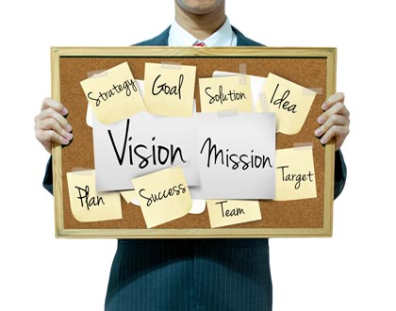
General Plans:
Comprehensive Plans:
Vision Plan
Example Elements:
-Circulation
-Transportation
-Environmental
-Community Development
-Housing
-Parks and Recreational
-Land Use Plans
City/Town
County
Municipal
County

Slide 93
http://www.cityofsafford.us/
Municipal

Slide 94
http://www.cityofsafford.us/
Municipal
Notes:
If you can not find the general plan under Departments, check planning or publications for city– or use search bar for PLAN or name of PLAN

Slide 95
http://www.cityofsafford.us/
Municipal

Slide 96
What if you wanted to create edible landscapes?
Municipal General Plan
Municipal

Slide 97
Community Design Element
Municipal General Plan
Municipal

Slide 98
Land Use
Neighborhood
Miramonte Neighborhood Plan

Slide 99
Transportation
Parks and Open Space
Land Use
Economic Development
Economic Development
Downtown Plans
Strategic
Neighborhood
Municipal
County
Regional
State
Federal

Slide 100
Downtown Revitalization Plan
Economic Development
Oro Valley
Notes:
Also good to check for downtown economic development plan is in Chandler economic development/ Town of Gilbert Downtown plan- Yuma Downtown Plan

Slide 101
Overview
The built environment we see around us is a component of our health, shaped by plans and policies.
It can influence our health and lifestyle choices within our communities through having parks and recreational spaces and better design in neighborhoods and streets.
There are different levels of government that affect planning (federal, state, county/regional, & local)
The different types of plans that take place can fall into four broad categories: transportation, parks and recreation, economic development, and land use.
Most plans have elements, strategies, goals, and policies that can influence health; the plans with the most direct impacts you can influence are regulated by the local level.

Slide 102
Questions?

Slide 103
Webinar 2
Thank You!
Stay Tuned:
How to Become a Change Agent
Friday: 8/15/16

