Slide 1
OLYMPIC PA BREAK

Slide 2
BOXING
The ever-popular men’s Boxing events are joined on the Olympic program by women’s events for the first time.

Slide 3
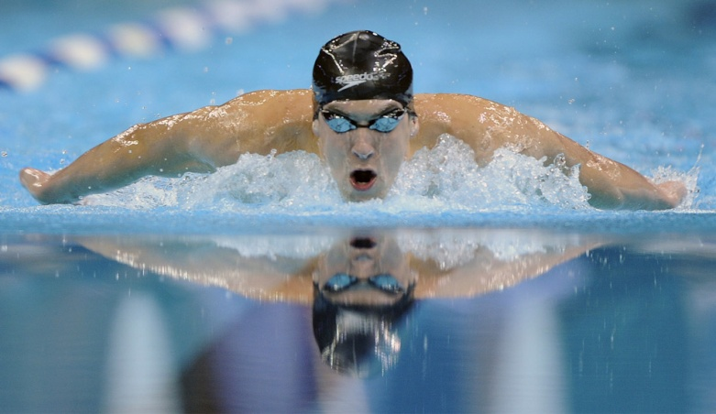
SWIMMING
Michael Phelps not only led his team to victory in 2008, but ultimately eclipsed the seven-gold medal champion Mark Spitz by taking a record eight golds in Beijing.

Slide 4
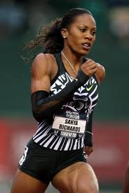
SPRINTING
In Athens, the first modern 100-meter dash was held at the summer Olympics in 1896. The tracks were not fast at this time, and the lanes were separated by ropes. Each runner had their own unique style of running as well as starting.

Slide 5
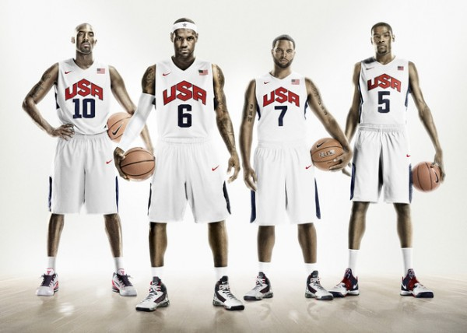
BASKETBALL
Men’s Basketball first appeared on the Olympic program at the Berlin 1936 Games, with the women’s event introduced at Montreal 1976.

Slide 6
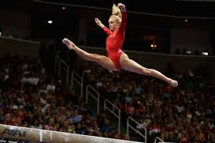
GYMNASTICS
The men’s individual apparatus and Team competitions first appeared at the Paris 1924 Games; a women’s Team event was introduced in 1928, with women’s individual apparatus competitions added in 1952.

Slide 7
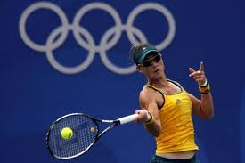
TENNIS
The Tennis competition at London 2012 will be held on the grass courts of Wimbledon.

Slide 8
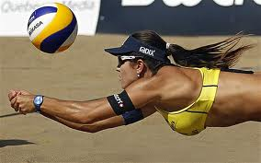
VOLLEYBALL
Beach Volleyball made its Olympic debut at Atlanta 1996. Since then it has become one of the most popular spectator sports at the Games.

Slide 9
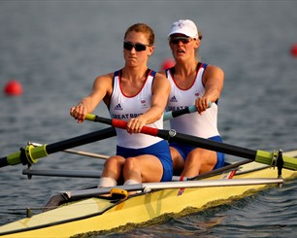
ROWING
Rowing is the only sport where competitors cross the finish line backwards.

Slide 10
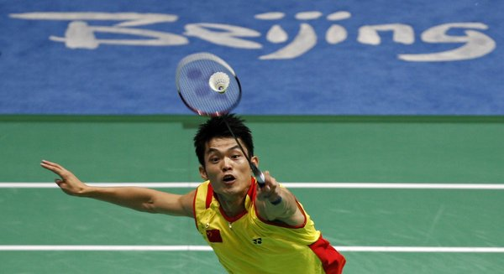
BADMINTON
One of the most dynamic Olympic sports, Badminton made its full Olympic debut at Barcelona 1992.
Asian countries now dominate: China, Indonesia and Korea have won 23 of the 24 gold medals awarded since the sport’s first appearance at the Games.

Slide 11
http://www.youtube.com/watch?v=66molzUEkWI&feature=player_embedded

