Slide 1



Webinar 2
How to Become a Change Agent

Slide 2



Welcome
Webinar 1
What Creates the Built Environment?
Stephanie Martinez, AZNN
Ryan Lang, AZNN
Leslie Dornfeld, PLAN-et
Christiane Quintans, PLAN-et
Webinar 2
How to Become a Change Agent?
40 min Webinar
20 min Q&A
Posted Online
Webinar 3
Who Can You Enlist to Help?

Slide 3
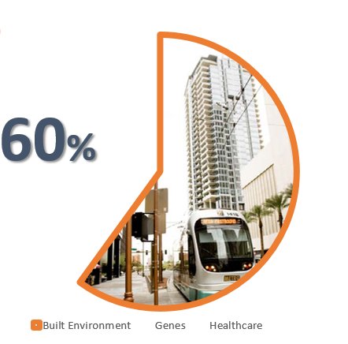
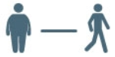





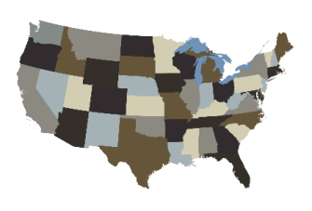

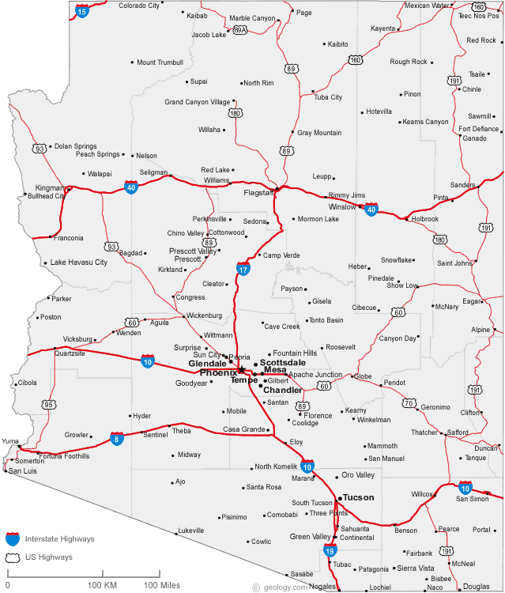
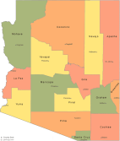
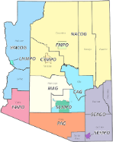




Last time…
The built environment we see around us is a component of our health, shaped by plans and policies.
Overview
Physical Activity
The different types of plans that take place can fall into four broad categories:
Transportation
Parks and Open Space
Economic Development
Land Use
There are different levels of government that affect planning (federal, state, county/regional, & local)
Webinar 1
What Creates the Built Environment?
Most plans have elements, strategies, goals, and policies that can influence health; the plans with the most direct impacts you can influence are regulated by the local level.

Slide 4
Now
Webinar 2
How to Become a Change Agent?

Slide 5
Why are we talking about the planning process?

Slide 6


Understanding the planning process is important
Citizens & Residents
Ad- Hoc Groups
Boards & Commission (Appointed)
Elected Bodies
Businesses
Influence
Authority

Slide 7
Understanding the planning process is important
Because YOU have a direct role in influencing authority and shaping plans so that they can create healthier environments
Influence
Authority

Slide 8
How do plans get made & What is the process?

Slide 9
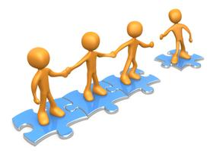




And plans, goals, strategies that direct actions to guide the future
Officials
Planners
Individuals
Any good plan reflects the community desires for the future
Ie: Parks, trails, & more bike lanes to address obesity

Slide 10
Transportation
Parks and Open Space
Economic Development
Land Use
Transportation
Parks & Open Space
Economic Development
Land Use
Transportation Master Plan
Planning Assistance for Rural Areas (PARAs)
Bike, Pedestrian, & Sidewalk
Corridor Plan
Comprehensive Plan
General Plan
Corridor Plan
Neighborhood Plan
Park Master Plan
Planned Area Developments (PADs)
Downtown Plans
Strategic
Remember, there are many different plans

Slide 11
Generally, all plan processes are the same…
Info
Goals
Plan
Implementation
Review/Revision

Slide 12
Generally, all plan processes are the same…
Info
Goals
Plan
Implementation
Review/Revision
Application
Public Meeting
Planning Commission
City Council
But some are a little different

Slide 13



For our purposes, we are going to focus on the general plan
General Plan
2016-2026
General Plan
2016-2026
& how you can influence it so our built environment can promote health

Slide 14
Why is the General Plan important?

Slide 15
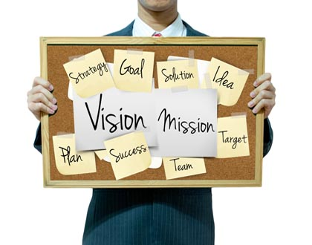
General Plan
ABOUT
A.K.A. Comprehensive Plan in County
General Plan
FORMING THE PLAN
Inform
Goals
Implementation
Update
Data
Scope
Survey/Feedback/Adopt
Amend
Most plans share the same process

Slide 16
General /Comprehensive Plan
Vision Plan/ Mission/ Foundation
GENERAL PLAN ELEMENTS
Circulation
Recreation
Growth Area
Land Use
Other
Conservation
Housing
Water Resources
Safety
Bicycling
Neighborhood Preservation & revitalization

Slide 17
General /Comprehensive Plan
Vision Plan/ Mission/ Foundation
GENERAL PLAN ELEMENTS
Circulation
Recreation
Growth Area
Land Use
Other
Conservation
Transportation Master Plan
Parks and Recreation Master Plan
Economic Development Strategies
Zoning
Housing
Water Resources
Safety
Bicycling
Neighborhood Preservation & revitalization

Slide 18
General /Comprehensive Plan
Vision Plan/ Mission/ Foundation
GENERAL PLAN ELEMENTS
Circulation
Recreation
Growth Area
Land Use
Other
Conservation
Transportation Master Plan
Parks and Recreation Master Plan
Economic Development Strategies
Zoning
Housing
Water Resources
Safety
Health
Bicycling
Neighborhood Preservation & revitalization

Slide 19
General /Comprehensive Plan
Vision Plan/ Mission/ Foundation
GENERAL PLAN ELEMENTS
Circulation
Recreation
Growth Area
Land Use
Other
Conservation
Transportation Master Plan
Parks and Recreation Master Plan
Economic Development Strategies
Zoning
Housing
Water Resources
Safety
Health
Bicycling
Neighborhood Preservation & revitalization
Notes:
The General Plan is important because it is the guide for zoning

Slide 20
Why is Zoning Important?

Slide 21

Zoning History
Impacts individual uses and behaviors that can happen on a site
Health→ built environment
Why Is Zoning Important?
Separation of land uses emerged from a concern of health and helped form early planning & zoning
As medicine and technology evolved (ie: toilets & sewage), Zoning began to include nuisances, & provide services over time.
Zoning and health split. Health began to address communicable diseases, and zoning created segregated uses that resulted in communities that rely on automobiles to connect destinations. Often these communities do not have healthy transportation options and other opportunities for physical activities like parks and trails.
Now, recent focus on land use and health seeks to address physical inactivity and chronic diseases associated with sedentary lifestyles encouraged by the built environment.

Slide 22
Zoning Process
Zoning must conform to the General Plan
GENERAL/ COMPREHENSIVE PLAN
Action: Build bike lanes
Zoning Map & Codes
Regulates land use and building codes on each individual property
A plan applies to many properties; zoning applies to one piece of property
What can I build Here?
How Can I build?
For example, can we build a grocery store in a C-2 zone? Or what is the minimum space required to build an elderly care home?
Parcel

Slide 23
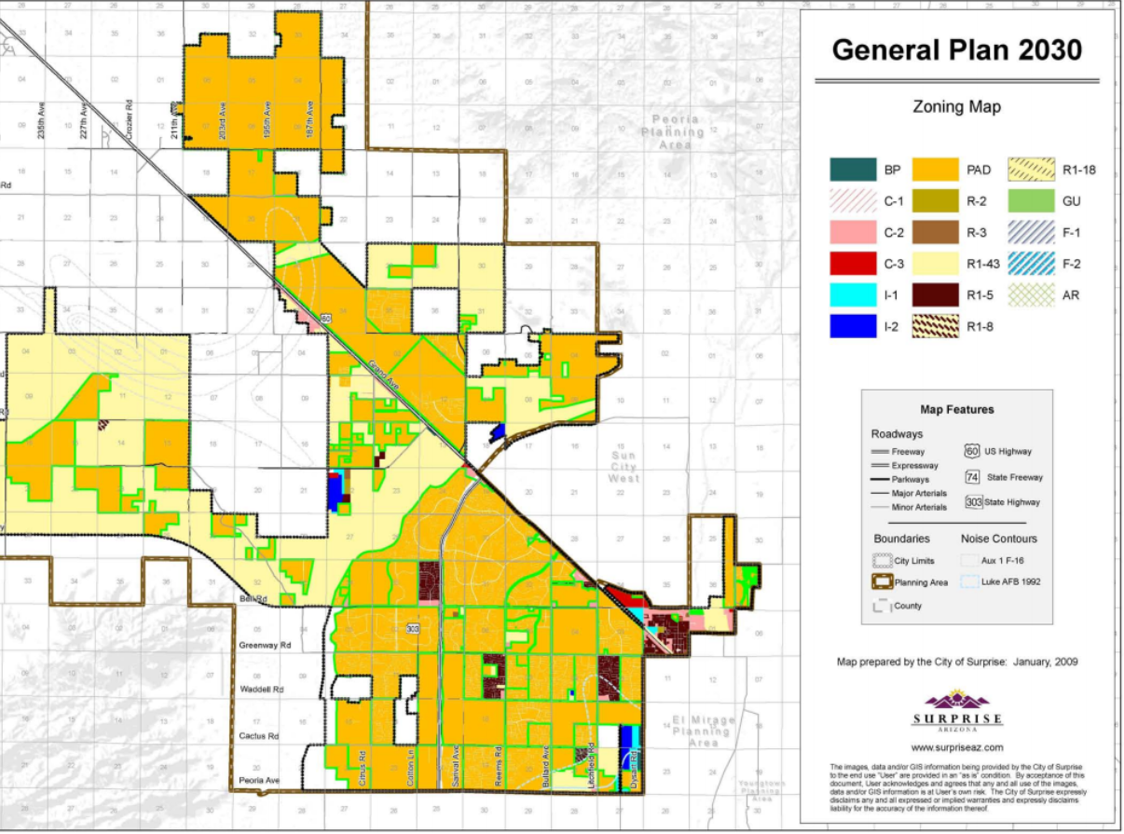
Zoning Map

Slide 24
Zoning Map
Zoning outlines regulations for setbacks, sidewalks, & specific land uses such as super markets, hospitals, clinics, and parks

Slide 25
Zoning Map
MUST Comply with the General Plan

Slide 26
Zoning Map
There are different zoning classifications

Slide 27
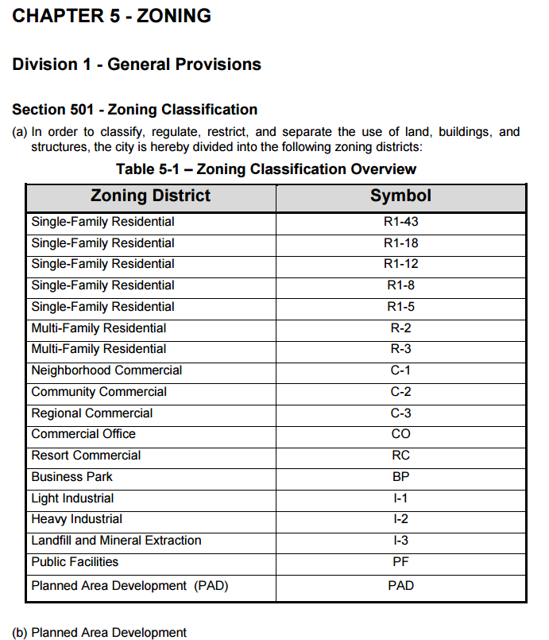
These classifications are defined in the zoning ordinance

Slide 28
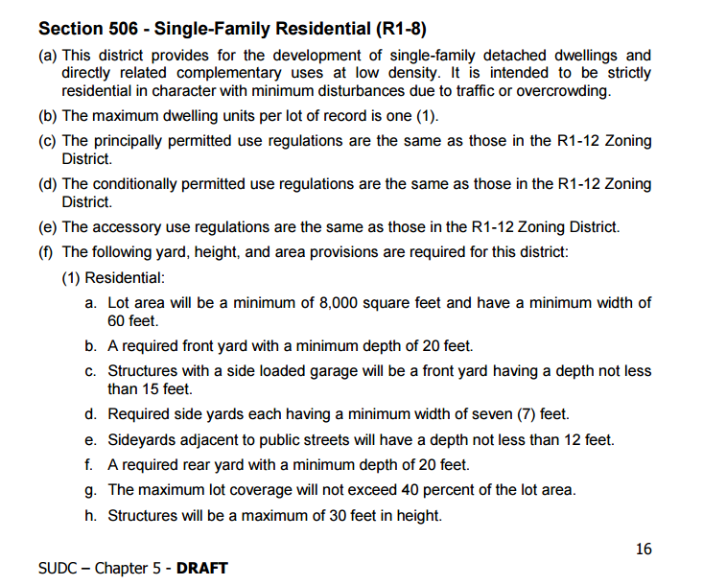
Which outlines allowed uses and restrictions

Slide 29
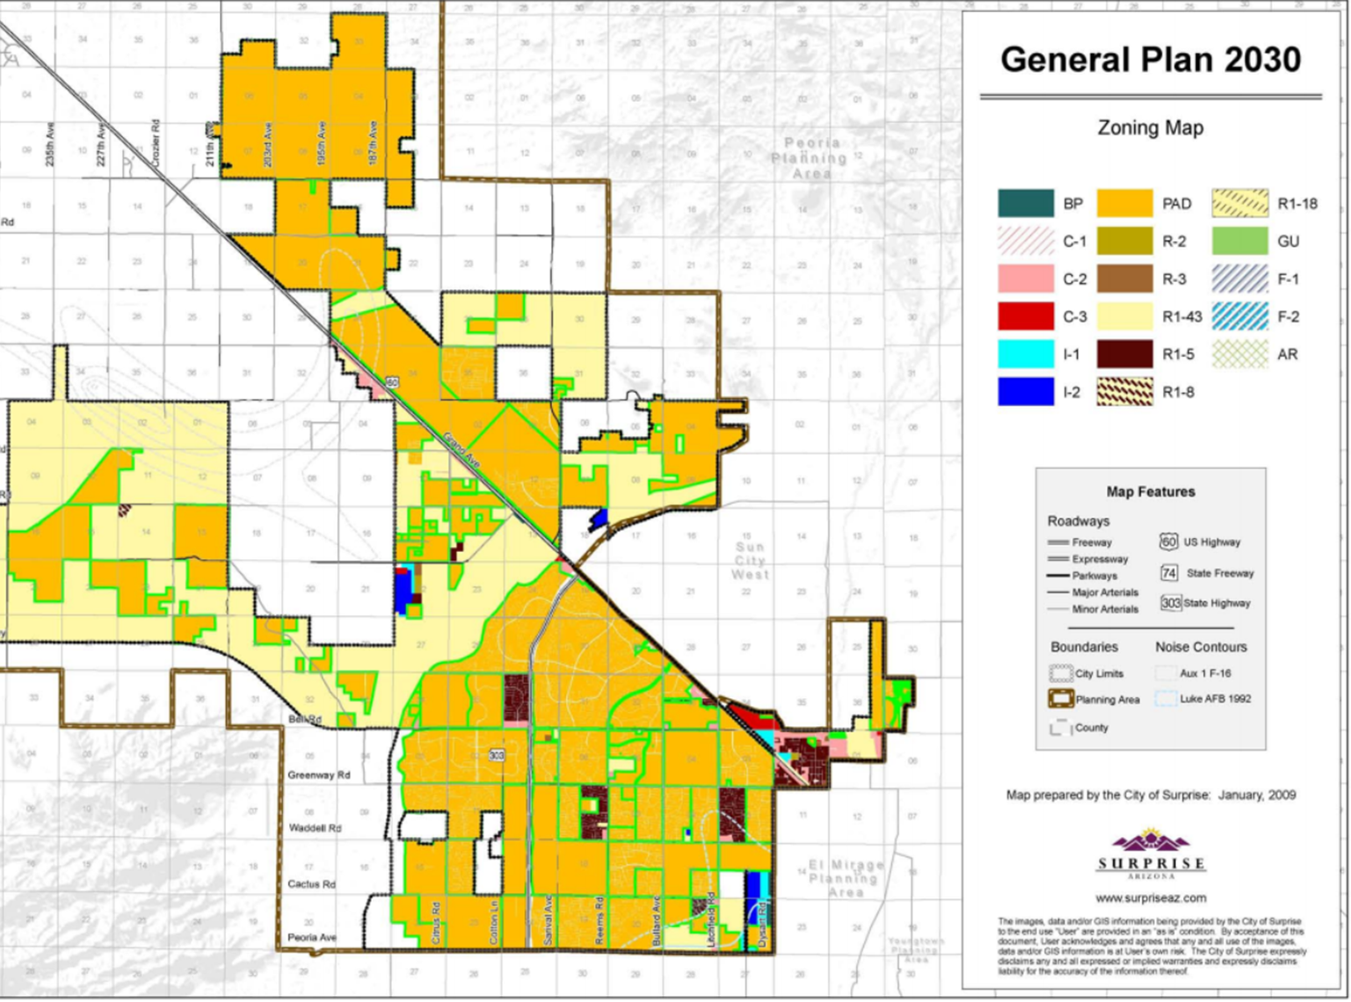
Zoning Process
ZONING
Plan→ built environment
General Plan
Zoning Ordinance (map)
Classification Categories (Specific Land Uses)
setback, sidewalks, & specific land uses such as super markets, hospitals, clinics, and parks
Parcel
Parcel

Slide 30
Zoning Process
ZONING
Plan→ built environment
General Plan
Zoning Ordinance (map)
PADs (Master communities)
Subdivisions
Classification Categories
Land Use
Pedestrian Networks, bicycle systems, and specific land uses
Parcel
Area

Slide 31
General Plans

Slide 32
Planning Process
Current Conditions
Trends & Projections
Visioning
Draft
Review
Adoption

Slide 33
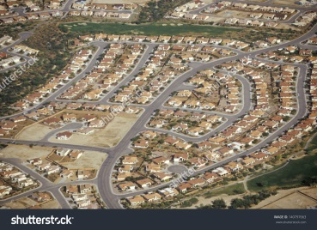
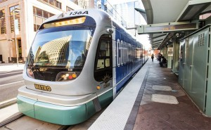
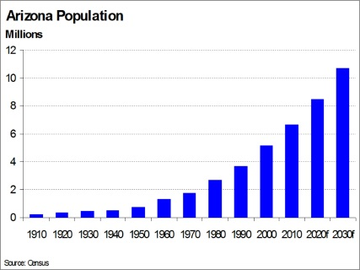

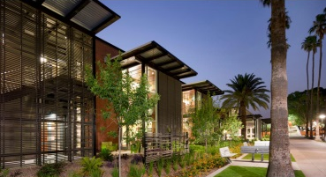
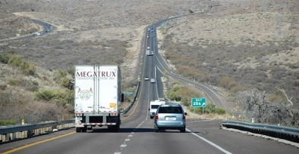
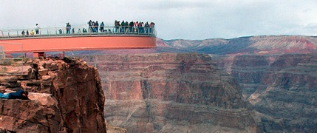
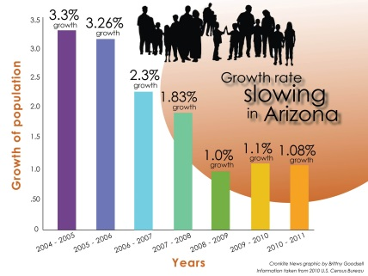
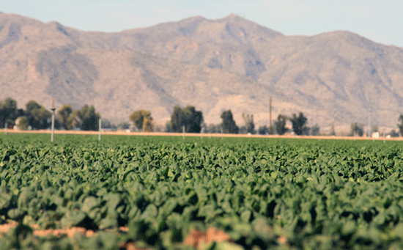
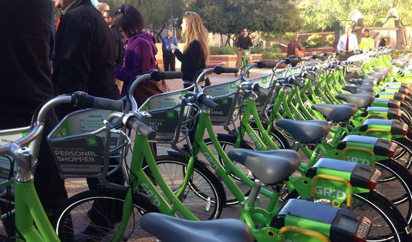

Step 1:
Current Conditions
Data/Information
What General Plan Focuses on
Community input in this section involves developing or providing existing data
Population Growth & Density
Economics
Land Use
Transportation

Slide 34
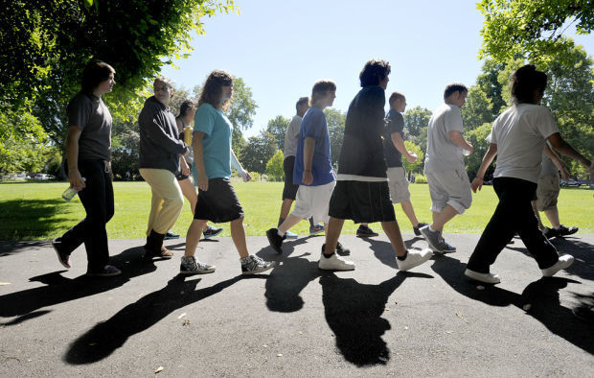
Step 1:
Current Conditions
Data/Information
Community input in this section involves developing or providing existing data
# of people walking to school or work, how many parks are located near households, obesity-related morbidity & mortality, childhood obesity rates, location of supermarkets, hospitals, income, etc.
Health data you can provide

Slide 35






Step 1:
Current Conditions
Data/Information
Provide these data to the General Plan Update Kick-Off

Slide 36
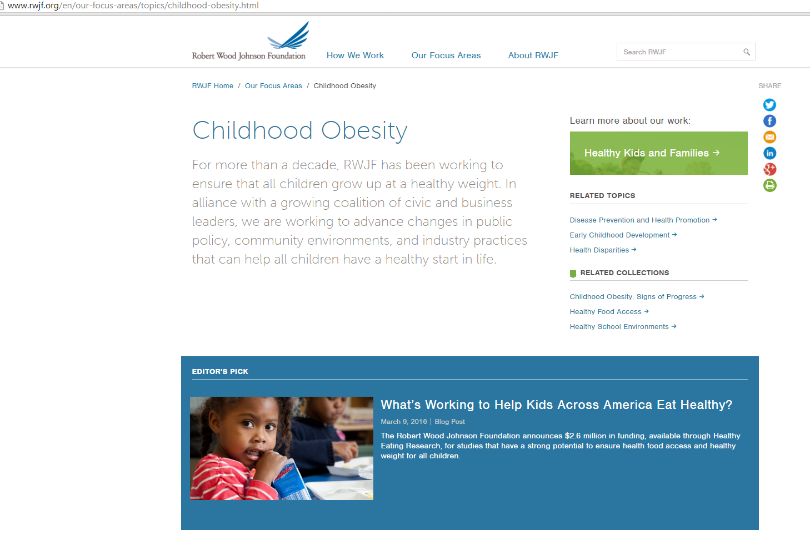
Current Conditions
Data/Information

Slide 37
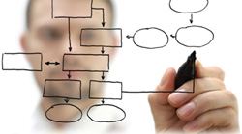
Step 2:
Trends & Projections
National & Local Level
Future development and transportation trends that will influence land use, employment trends, sustainability trends
What GP will look at

Slide 38
Step 2:
Trends & Projections
National & Local Level
Morbidity rates for obesity, diabetes, & CVDs; depression; # automobile owners & commuting modes; demographic shifts; aging
What health focused trends look like

Slide 39





Step 2:
Trends & Projections
National & Local Level
http://hints.cancer.gov/
http://www.nhats.org/
Look at national trends, benchmark, CDC, medical journals
http://www.cdc.gov/mmwr/distrnds.html
http://www.ncbi.nlm.nih.gov/pubmed

Slide 40
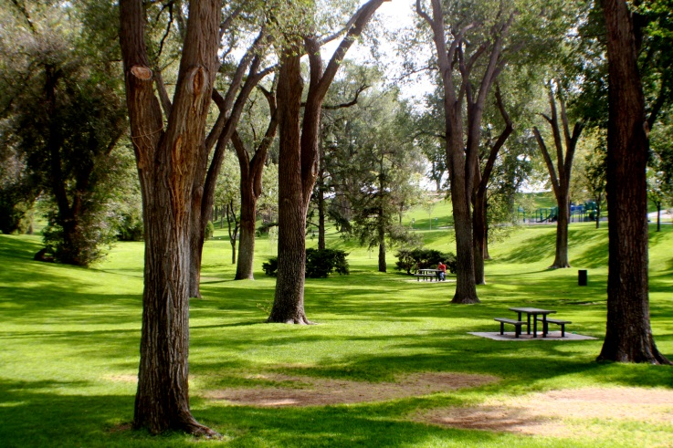
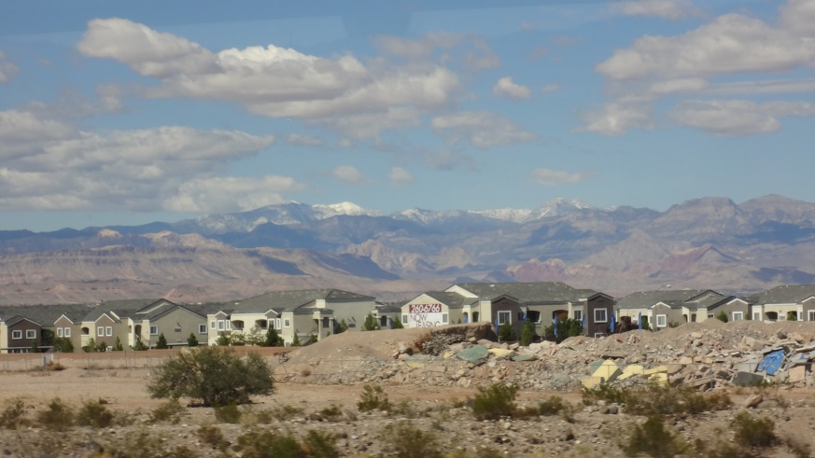
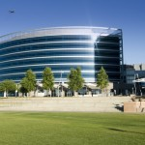
Step 3:
Visioning
Community assesses the future
What type of development do you want? Where do you want apartments and commercial?
What kinds of transportation facilities do you want? Where should be parks located/ how far should houses be from parks?

Slide 41
Step 3:
Visioning
Community assesses the future
Health perspective on desired future
Where should parks be located in order to reduce obesity-related disease?
Can we have community gardens to increase access to healthy foods?
Where can we address community design that impacts obesity and physical activity?
How can we increase access to everyone to supermarkets and hospitals?

Slide 42
Step 3:
Visioning
Community Involvement
Through community involvement, a health perspective can be provided to the vision
Community Input

Slide 43
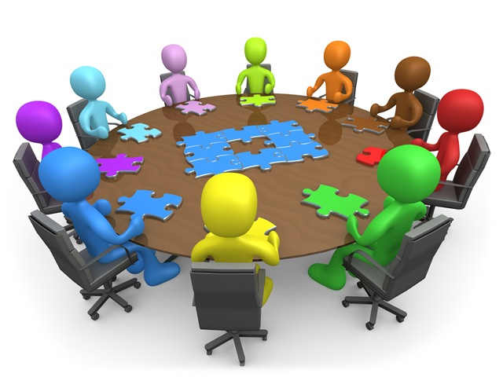
Community Input
Focus Meetings
Surveys
Charrettes
Neighborhood Forums
You can contribute in forming the goals, strategies, and actions

Slide 44
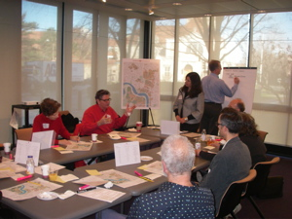
Community Input
Focus Meetings
Where you get 1-1 time with the people developing the plan

Slide 45

Community Input
Surveys
Rely on large constituency, so make sure there are health-related questions
Ie: how active would you like to be?
Does community provide places for physical activity? Is it easy for you to access healthy food?

Slide 46
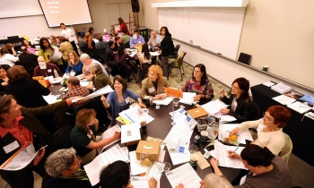
Community Input
Charrettes
Design-workshops that address land use from a health perspective
Participation may include recommendations for specific land-use categories that encourage physical activity; identify where paths and trails are needed to connect destinations

Slide 47
Community Input
Neighborhood Forum
Take many forms and provide opportunity to educate other people about health & put important issues on the table
Where comments are requested on plan/work product; for initial input

Slide 48
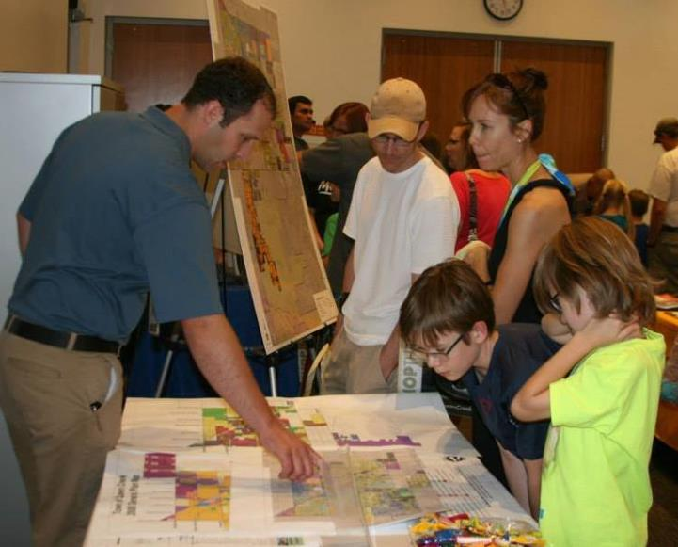
What else is community input used for in the process?
Community Input
Ideas and desires that planners use develop plan goals, policies actions

Slide 49
Step 4:
Goals, strategies, and actions
Draft
Definitions:
Goals- What do you want to achieve?
Strategies- How do you want to execute the plan?
Actions- What needs to happen or take place?
Example:
Goal- Reduce childhood obesity
Strategies- Provide more amenities that promote physical engagement and pedestrian activities
Actions- Add bike lanes, parks, and shade
Ie: land use can impact health by providing diverse modes of transportation and accommodating more public transit stops

Slide 50
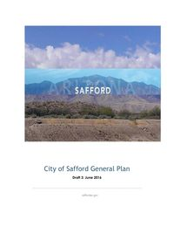
Step 4:
Goals, strategies, and actions
Draft
The plan is drafted
Ie: land use can impact health by providing diverse modes of transportation and accommodating more public transit stops

Slide 51

Step 5:
Boards and Commissions & Other Advisory Bodies
Review
Plan is reviewed by the Planning Commission
60 Day Review (AZ Only)
Inform other state agencies and adjacent jurisdictions (+ county)
Plan is also available to the public for review and comments, questions, and set of scheduled hearings.

Slide 52
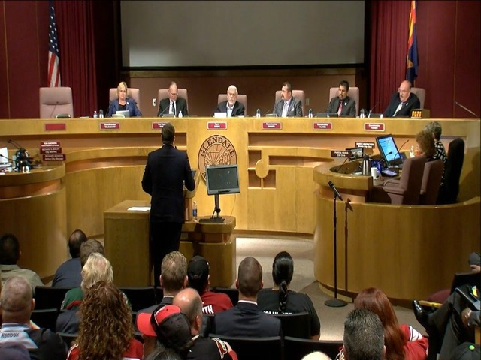
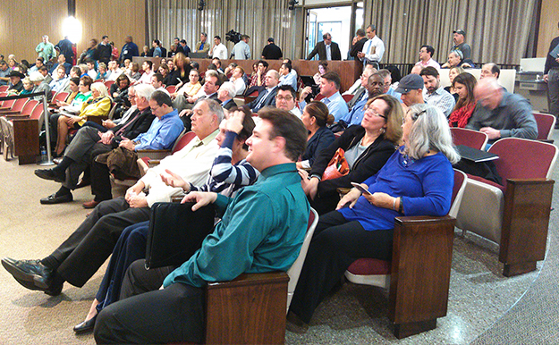
Step 6:
Public Hearings
Adoption
Depending on size of jurisdiction it planning commission (1-2 planning hearings)
Then a City Council hearing

Slide 53

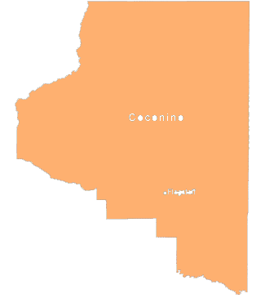
Step 6:
Adopt the Plan
Adoption
Depending on growth rate & size of jurisdictions (AZ Only) the plan may be sent to voters for ratification

Slide 54
Planning Process
Get Involved!
Plan Kick-Off
Provide information and reports of trends and health statistics
Current Conditions
Trends & Projections
Visioning
Draft
Review
Adoption
Public Engagement
Insert what you want to see to include in plan & inform other residents of health issues
Review Draft
Look to see if health is missing in any areas or left unaddressed
Public Hearing Process & Ratification

Slide 55
How do you know if a general plan is required where you are?

Slide 56


How do you know if a general plan is required where you are?
Most states require a General Plan
http://www.azleg.state.az.us/arizonarevisedstatutes.asp
Like Arizona

Slide 57
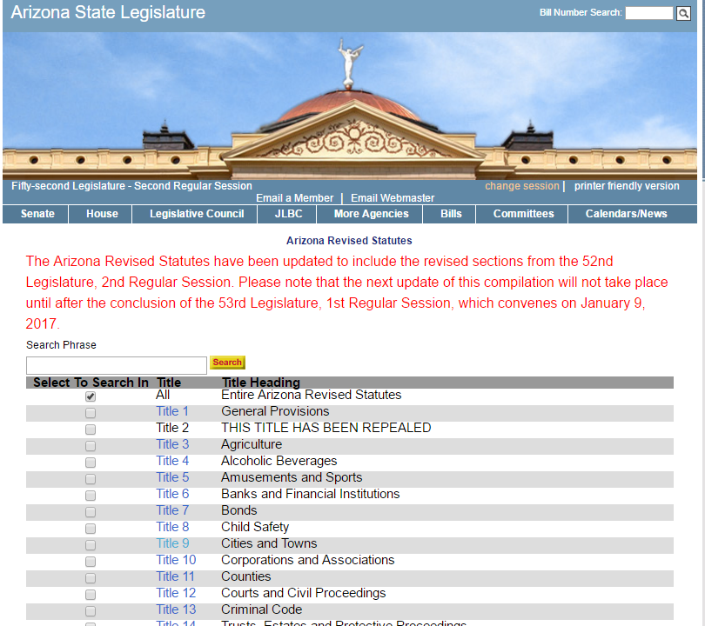
Arizona General Plans are found in Title 9
Notes:
http://www.flagstaff.az.gov/DocumentCenter/Home/View/8317- state statutes relating to municipalities General Plan

Slide 58
Arizona General Plans are found in Title 9
Notes:
http://www.flagstaff.az.gov/DocumentCenter/Home/View/8317- state statutes relating to municipalities General Plan

Slide 59
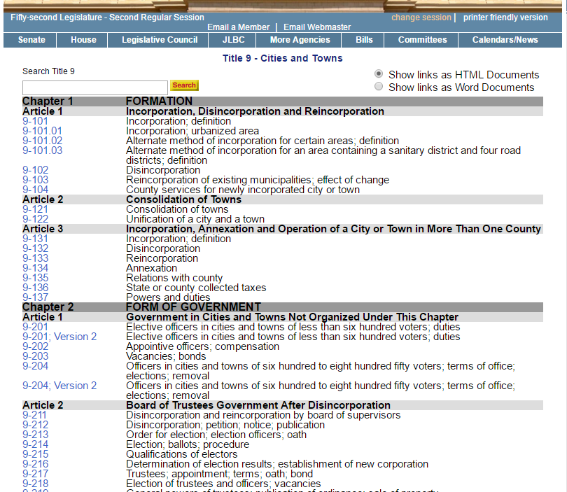
Notes:
http://www.flagstaff.az.gov/DocumentCenter/Home/View/8317- state statutes relating to municipalities General Plan

Slide 60
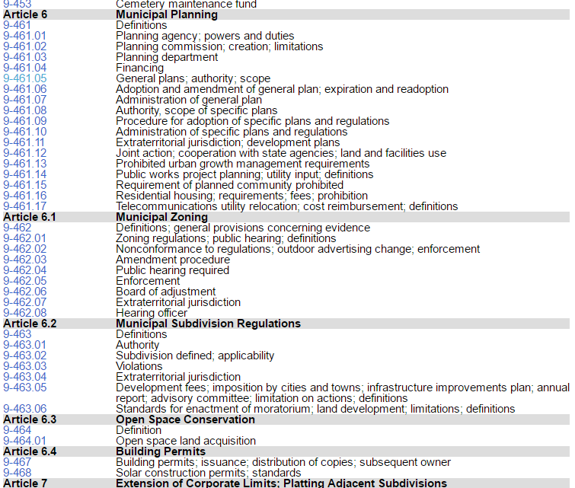
The place to check for AZ General Plans for cities is Title 9-Chapter 4, Article 6
Particularly for General Plans, you can find info here
Notes:
http://www.flagstaff.az.gov/DocumentCenter/Home/View/8317- state statutes relating to municipalities General Plan

Slide 61
The place to check for AZ General Plans for cities is Title 9-Chapter 4, Article 6
Zoning and Subdivision Regulations can be found in 6.1 &6.2
Notes:
http://www.flagstaff.az.gov/DocumentCenter/Home/View/8317- state statutes relating to municipalities General Plan

Slide 62
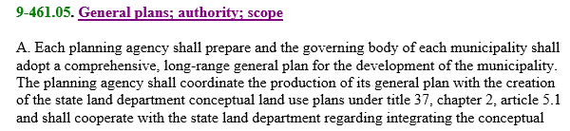
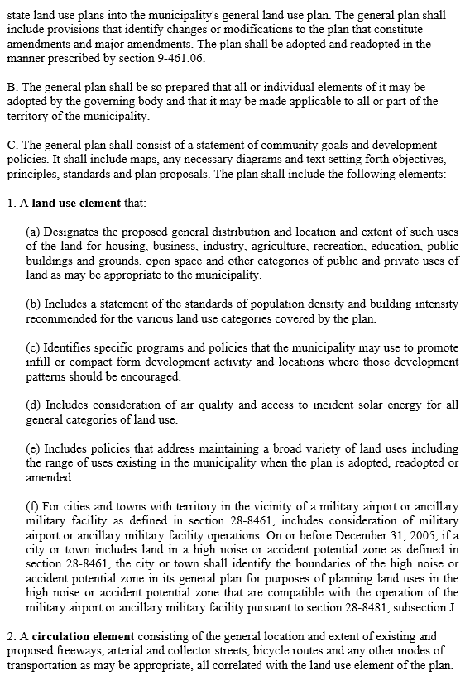
There are required elements in each general plan that include:
Land Use
Circulation
Notes:
http://www.flagstaff.az.gov/DocumentCenter/Home/View/8317- state statutes relating to municipalities General Plan

Slide 63
There are required elements in each general plan that include:
Open Space
Growth Area
Environmental Planning
Cost of Development
Water Resources
Cities & Towns 2,500+ persons & ~2%/yr. growth rate
Notes:
http://www.flagstaff.az.gov/DocumentCenter/Home/View/8317- state statutes relating to municipalities General Plan

Slide 64
Conservation
Recreation
Circulation
Public Services and Facilities
Public Buildings
Housing
Conservation, Rehabilitation, & Redevelopment
Safety
Bicycling
Energy
Neighborhood Preservation & revitalization
Cities & Towns 50,000 + persons
Notes:
http://www.flagstaff.az.gov/DocumentCenter/Home/View/8317- state statutes relating to municipalities General Plan

Slide 65

How about in other areas?
New Mexico

Slide 66
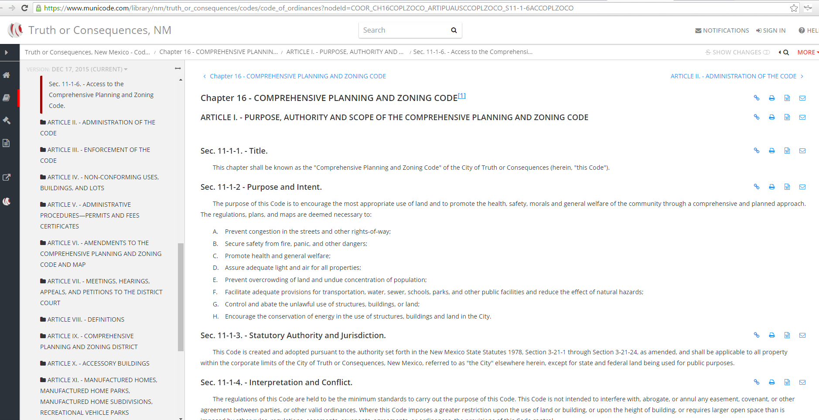
How about in other areas?
New Mexico

Slide 67
How You Can Get Involved

Slide 68
Things to Keep in Mind:
Staff & Financial Resources
  Budgeting (CIPs), manpower
Public/ Political Support
  Informing Citizens, getting involved & political people involved
Date & Organization
  Timing and extent of plan (GPs are every 10 years, but you can get involved in the annual plan updates)

Slide 69
General/Comprehensive Plan
1. GP Update-Every 10 Years
  Inform health actions that could be taken, goal, or an entire separate health element
2. Selective Amendments
  Expand health aspect (ie: provide goals/policies for non-motorized transportation or add air quality element).
3. Revised Codes or Ordinances
  Pedestrian-oriented overlay zone
4. Separate Health-related Plans
  Bike & Pedestrian Plans

Slide 70
Overview
YOU can influence the authority that enables the decisions that shape plans for the built environment, and impact our health.
The General Plan is a foundational plan for cities and towns, and is also called a Comprehensive Plan on the County level.
Current Conditions
Trends & Projections
Visioning
Draft
Review
Adoption
The General Plan has several elements that form other Master Plans; the processes are similar.
Zoning is a subset process of the Land Use element, and is important in applying the plan to the built environment.
In the planning process there are four areas you can get involved in: Providing information, scoping goals, participating in adoption, and making amendments.
You can find the legal authority and requirements of the General Plan in the Arizona Revised Statutes (ARS Title 29, Chapter 4, Article 6 )

Slide 71
Questions?

Slide 72


Thank You!
Stay Tuned:
Webinar 3
Who Can You Enlist to Help?
Friday: 9/22/16

