Slide 1
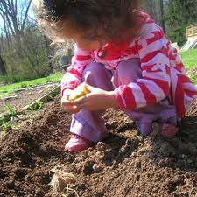
Grow to Learn Arizona – opportunity for nutrition experiences in gardens and farmers’ markets
Allison Parisi-Giles
Farmers’ Market Nutrition Program

Slide 2
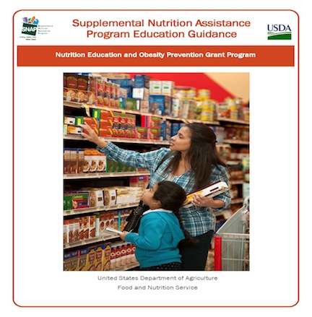

Slide 3
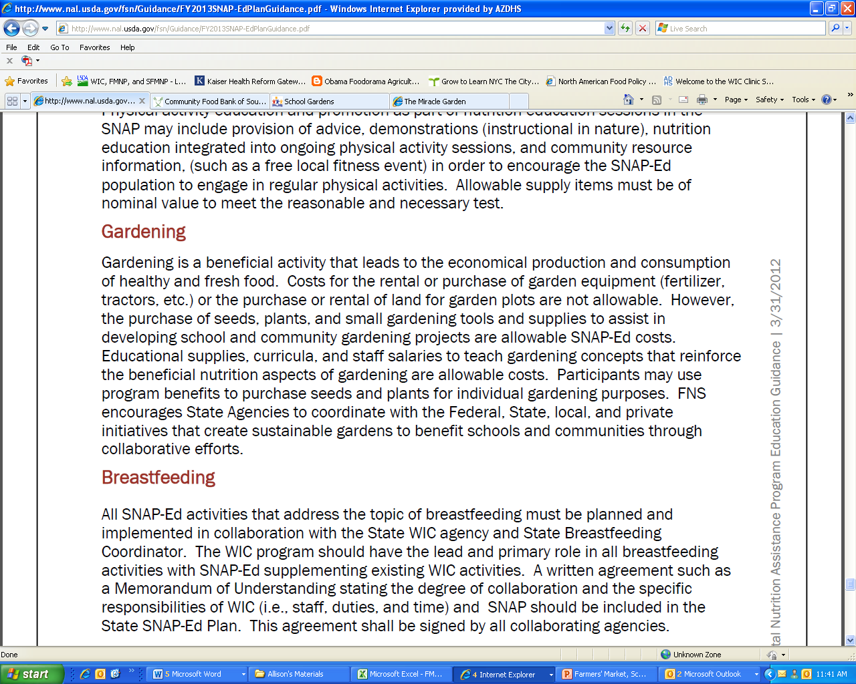
Opportunity for Nutrition Education Experiences

Slide 4
Gardens:
Nutrition Education Classrooms
Allowable | Not Allowable
Purchase of seeds, plants, small gardening tools | Rental or purchase of equipment (tractors)
Educational Supplies, curricula | Rental or purchase of land
Staff salaries to teach gardening concepts that reinforce nutritional concepts

Slide 5
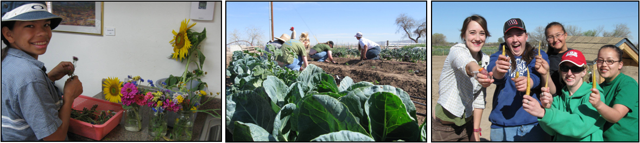
Gardens:
Nutrition Education Classrooms
School gardens and community gardens offer opportunity partnerships in wellness and education.

Slide 6
The Big Questions
Can produce grown in School Gardens be used in cafeterias?
  Can produce grown in School Gardens be used in nutrition education activities?

Slide 7
School Cafeterias
School kitchen facilities:
fall under the Arizona Food Code
must use foods that are from an “Approved Source” (definition determined by Local Health Authorities; County Health Departments).
Notes:
School kitchens fall under the jurisdiction of the Arizona Food Code, which states that kitchen facilities may only use foods considered an “approved source”. The Arizona Food Code leaves this definition up to the local health authority. The local healthy authority is considered the county health department in this instance. In the past, county health departments considered school garden produce to be an unapproved source for use in kitchen facilities. To accommodate those looking for guidance on food safety in school gardens, the Arizona Department of Health Services has drafted a set of guidelines based on the United States Department of Agriculture’s Good Handling Practices and Good Agricultural Practices (page 6). It is the intention that the local health authority applies these guidelines to establish criteria for approved sources of food pertaining to garden produce for use in school kitchen facilities. These criteria are not mandatory for compliance with federal Child Nutrition Programs, however, it is strongly recommended for those schools choosing to serve produce from the school garden.

Slide 8
School Cafeterias
  Historically, food from school gardens was not an approved source.
  Many schools started asking how they could get the produce from their gardens into the cafeteria.
Notes:
School kitchens fall under the jurisdiction of the Arizona Food Code, which states that kitchen facilities may only use foods considered an “approved source”. The Arizona Food Code leaves this definition up to the local health authority. The local healthy authority is considered the county health department in this instance. In the past, county health departments considered school garden produce to be an unapproved source for use in kitchen facilities. To accommodate those looking for guidance on food safety in school gardens, the Arizona Department of Health Services has drafted a set of guidelines based on the United States Department of Agriculture’s Good Handling Practices and Good Agricultural Practices (page 6). It is the intention that the local health authority applies these guidelines to establish criteria for approved sources of food pertaining to garden produce for use in school kitchen facilities. These criteria are not mandatory for compliance with federal Child Nutrition Programs, however, it is strongly recommended for those schools choosing to serve produce from the school garden.

Slide 9

School Cafeterias
  Arizona Department of Education created a Food Safety Plan including School Garden Guidelines and Toolkit.
Notes:
School kitchens fall under the jurisdiction of the Arizona Food Code, which states that kitchen facilities may only use foods considered an “approved source”. The Arizona Food Code leaves this definition up to the local health authority. The local healthy authority is considered the county health department in this instance. In the past, county health departments considered school garden produce to be an unapproved source for use in kitchen facilities. To accommodate those looking for guidance on food safety in school gardens, the Arizona Department of Health Services has drafted a set of guidelines based on the United States Department of Agriculture’s Good Handling Practices and Good Agricultural Practices (page 6). It is the intention that the local health authority applies these guidelines to establish criteria for approved sources of food pertaining to garden produce for use in school kitchen facilities. These criteria are not mandatory for compliance with federal Child Nutrition Programs, however, it is strongly recommended for those schools choosing to serve produce from the school garden.
School kitchens fall under the jurisdiction of the Arizona Food Code, which states that kitchen facilities may only use foods considered an “approved source”. The Arizona Food Code leaves this definition up to the local health authority. The local healthy authority is considered the county health department in this instance. In the past, county health departments considered school garden produce to be an unapproved source for use in kitchen facilities. To accommodate those looking for guidance on food safety in school gardens, the Arizona Department of Health Services has drafted a set of guidelines based on the United States Department of Agriculture’s Good Handling Practices and Good Agricultural Practices (page 6). It is the intention that the local health authority applies these guidelines to establish criteria for approved sources of food pertaining to garden produce for use in school kitchen facilities. These criteria are not mandatory for compliance with federal Child Nutrition Programs, however, it is strongly recommended for those schools choosing to serve produce from the school garden.

Slide 10
School Garden Guidelines
  Based on Good Agricultural and Good Handling Practices.
  Created by Arizona Department of Education in accordance with the Arizona Department of Health Services.

Slide 11
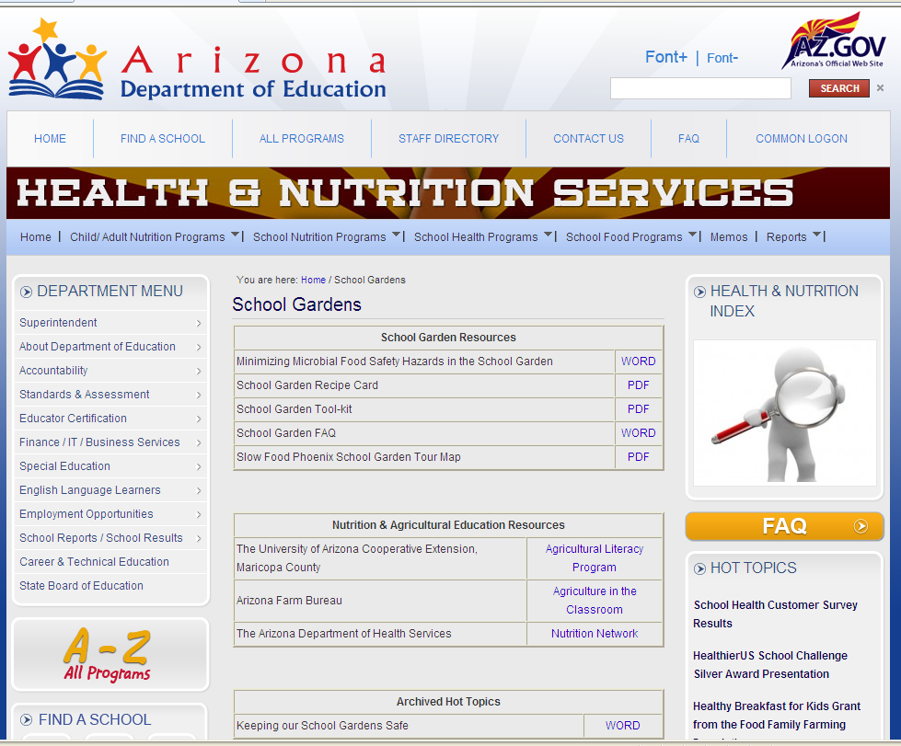
Where to find the information

Slide 12
School Cafeterias
    A solid Food Safety Plan in place will help the cause!
Each school is responsible for asking their respective County Health Department their garden produce may be considered an “approved source”…used regularly for cooking, salad bars, etc.
Notes:
School kitchens fall under the jurisdiction of the Arizona Food Code, which states that kitchen facilities may only use foods considered an “approved source”. The Arizona Food Code leaves this definition up to the local health authority. The local healthy authority is considered the county health department in this instance. In the past, county health departments considered school garden produce to be an unapproved source for use in kitchen facilities. To accommodate those looking for guidance on food safety in school gardens, the Arizona Department of Health Services has drafted a set of guidelines based on the United States Department of Agriculture’s Good Handling Practices and Good Agricultural Practices (page 6). It is the intention that the local health authority applies these guidelines to establish criteria for approved sources of food pertaining to garden produce for use in school kitchen facilities. These criteria are not mandatory for compliance with federal Child Nutrition Programs, however, it is strongly recommended for those schools choosing to serve produce from the school garden.

Slide 13
What about nutrition education activities????
Arizona Directors of Environmental Health Services Association met on July 25.
They agreed that fruits and vegetables served in an educational setting fall under an exemption in the Food Safety Rules

Slide 14
Exemption
R9-8-102. Applicability
B. This Article does not apply to the following, which are not subject to routine inspection or other regulatory activities by a REGULATORY AUTHORITY:
9. Food or drink that is:
e. Offered at a child care facility and limited to commercially prepackaged food that is not potentially hazardous and whole fruits and vegetables that are washed and cut onsite for immediate consumption.

Slide 15
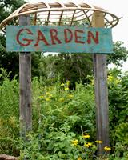
Exemption
- would apply to schools and educational settings
- would only apply if the whole fruit and vegetables used for immediate consumption

Slide 16
Good Gardening!
Whether working with children or adults in a garden setting, safety is always foremost.
School Garden Guidelines are good practice for every garden, whether produce will be served in cafeteria, food experience, or taken home to eat.

Slide 17
Information available for you today
List of Environmental Health Directors and contact information
School Garden Guidelines
School Garden Toolkit
www.azed.health-nutrition/school-gardens/

Slide 18

Taking the experience home
Notes:
We have some laminated posters here for you to take and place in locations where SNAP recipients will see them. Can use their SNAP benefits to start their own gardens.

Slide 19

Contact me for nutrition education opportunities around gardens and farmers’ markets!
Allison Parisi-Giles
Farmers’ Market Nutrition Program
602-542-0389 allison.giles@azdhs.gov

