Slide 1
Active Living Subcommittee
May 16th, 2017
WELCOME

Slide 2
Time | Topic | Presenter
10:00- 10:05 AM | Welcome and roll call Any AZNN updates: | Ryan Lang
10:05- 10:20 am | Project Design and Management. | Kevin Bawden
10:20- 10:35 AM
10:30- 10:45 AM
10:45- 11:00 AM | Open Discussion: (How can we use PDM in our daily activities, or PSE Efforts and as we work to achieve our program objectives?) | Group

Slide 3
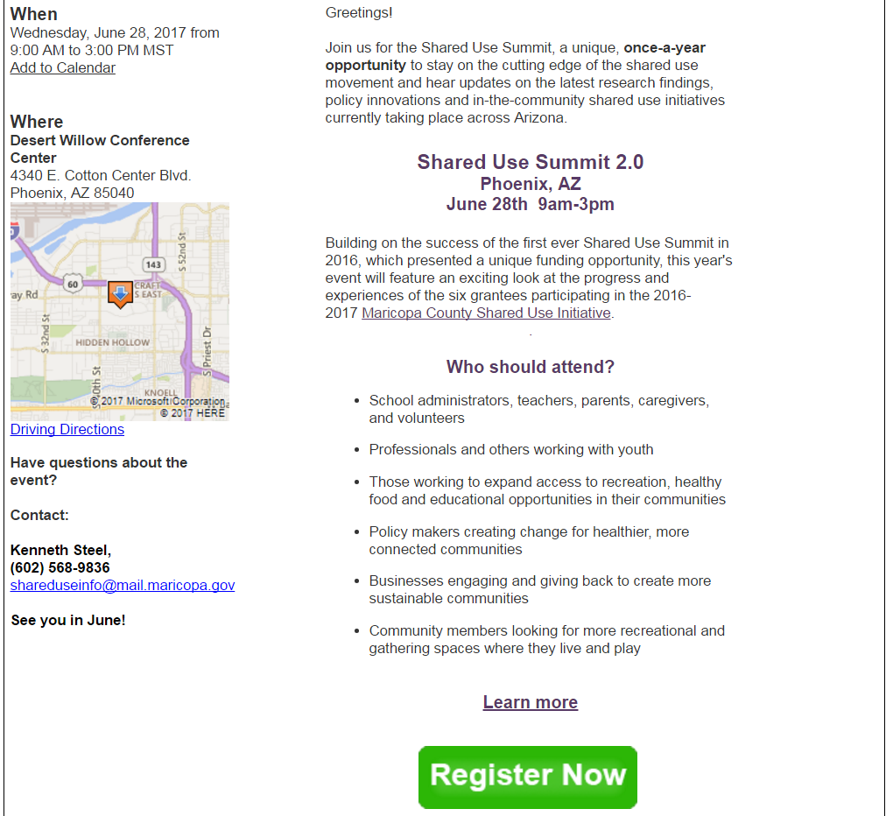
MCDPH Shared-Use Summit
When
Wednesday, June 28, 2017
9:00 AM to 3:00
Where
Desert Willow Conference Center
4340 E. Cotton Center Blvd.
Phoenix, AZ 85040

Slide 4
Project Design and Management
Skills and Techniques

Slide 5

Why is this important for everyone
With this we are not trying to create new programs, but are simply trying to fulfill the Specific Goals of our programs; so always keep in mind how the work you’re doing fits into these needs.
This will help speed up the process of approval for purchases as well as sites.
There are many different aspects of our programs that we fulfill with workshops and events. It is very important that we, as program and education staff, have a sense of ownership for our work. This will provide us the ability to speak clearly with site location staff about what type of project we hope to hold in their sites.
This will also allow us to clearly provide the state with reasons when altering budgets and approving site locations.

Slide 6
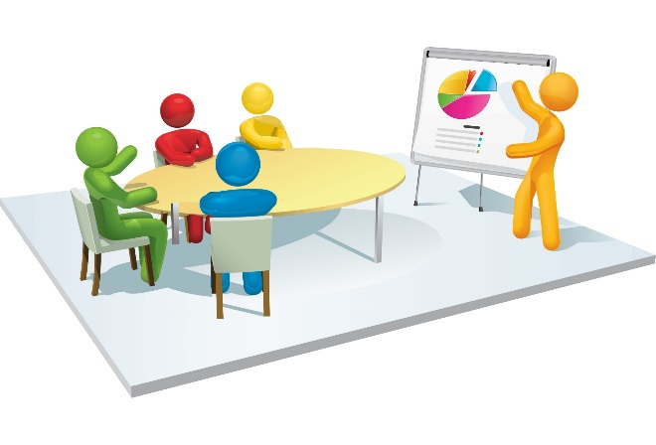
Project Definition
A temporary endeavor undertaken to create a unique product or service.
A project is a unique venture with a beginning and an end, conducted by people to meet established goals within parameters of cost, schedule, and quality.

Slide 7

Programs versus Projects
Program
(Large scale grants and other specific programming)
More than one sector, longer time-frame, usually one county, but possibly multi-county
All people affected by outcomes of various projects that make up the program, which may include people both directly involved and not directly involved with project activities
Normally multiple funding sources, such as the SNAP-Ed Grant
Project goal and program goal tackling immediate problems, underlying issues, or root causes of poverty; County Work Plans
Program and education staff
Responsible for coordinating projects making up the program
Notes:
Keep in mind that programs are large, generally long term endeavors such as the SNAP-Ed grant or FTF Grants. They have many different pieces that create the whole that are generally broken down into smaller pieces.

Slide 8
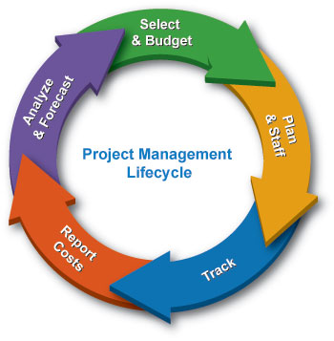
Programs versus Projects
Project
(Workshops or other things within a program)
Usually one sector, short time frame, more focused, usually one county or community
Specific individuals and groups who directly participate in project activities or workshops in order to learn about or tackle a specific topic
Normally one funding source (all funding for our projects come from SNAP-Ed funds)
Inputs, activities, outputs, outcomes tackling immediate problems, underlying issues, or root causes of poverty; workshop outcomes
Directly responsible and accountable for delivering activities and outputs –attribution.
Notes:
Projects are typically the smaller pieces of programs and work to accomplish specific objectives within the program itself. Projects can be short term or ongoing through the life of a program to accomplish these specific tasks. But they should also have a clear definition of work as well.

Slide 9

What does this mean for you
It is very important that we have a clear goal in our mind when we set up our workshops or if we are trying to set up new sites. Ask yourself:
Who benefits?
What am I trying to accomplish?
What resources will I need?
Are there things that I will need that we don’t have, or that aren’t approved?
Is this the right time to start this project/workshop?
Notes:
While this may not seem important at some levels, these concepts are designed to help us better understand the work we are doing. They will also help us conduct ourselves in a much more structured and professional manner to support the goals and objectives of the overall program, and help ensure the work we are doing is addressing said needs.

Slide 10
Seasonal Calendar
Lets face it , we live in Arizona. The seasons around the state are different and we can’t always work the same way another county does. We may see a project in another county that works really well…. There. But we need to think about our here.
When are people the busiest?
  Is it the same for men & women, children and families? Are community members able to attend?
Are there any indications when transportation would be an issue, if a project relied on it?
Might weather affect a project?
  Temperature, inclement weather conditions such as rain and snow.
What influences might social events, national holidays, school schedules, or local government have on projects?
Notes:
Never underestimate the power of this; many programs fail because seasonal needs were not taken into account for the life of the program….. Thus what do you think this could mean for a project?

Slide 11

Project Planning
What is the problem? How are you going to approach it? What are the outcomes?
Notes:
The flow of your project, this will help us identify what we want to accomplish, and it will also help us identify the work we need to be doing moving forward. Situation, action, new situation… and so on.

Slide 12
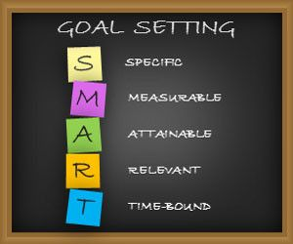
Goals and Objectives
Goals
  Define long-term results or changes that the project will bring about.
    The goals are usually set by the program, such as with SNAP-Ed, thus how does your project fall within the program goals and how will it impact the program?
  Are realistic and include an overall time frame.
    For example “To increase daily MVPA and provide a family friendly venue in which to_________” – this is a program goal; your project goal should be more specific to the workshop and location you are going to be using.
    Time frame could be defined or not, depending on the project life cycle.
      We work with approved curricula that span different time frames, so ask yourself if this will be a one time workshop or repeated, and how could that impact the needs of the project.
Notes:
Yes, there are goals for the program already in place. However, should we not have goals for our individual projects? What are you hoping to accomplish by holding a workshop? How does the workshop fit within the program goals (which program goals is it helping to fulfill)? Will this be an ongoing endeavor or a one time thing… These are all questions we should ask when setting projects to ensure that we are selecting and accomplishing appropriate tasks in order to be successful and professional in our work.

Slide 13

Goals and Objectives
Objectives:
Are the short-term results that help you meet the longer-term goals of the program (SNAP-Ed).
Answer the questions:
  Who is the target group or individuals expected to change?
  What action or change is expected?
  When will the desired action or change be accomplished?
  How much change is expected?
  We have program goals and objectives for SNAP-Ed; however we should have project objectives that make it possible for us to meet the program goals.

Slide 14
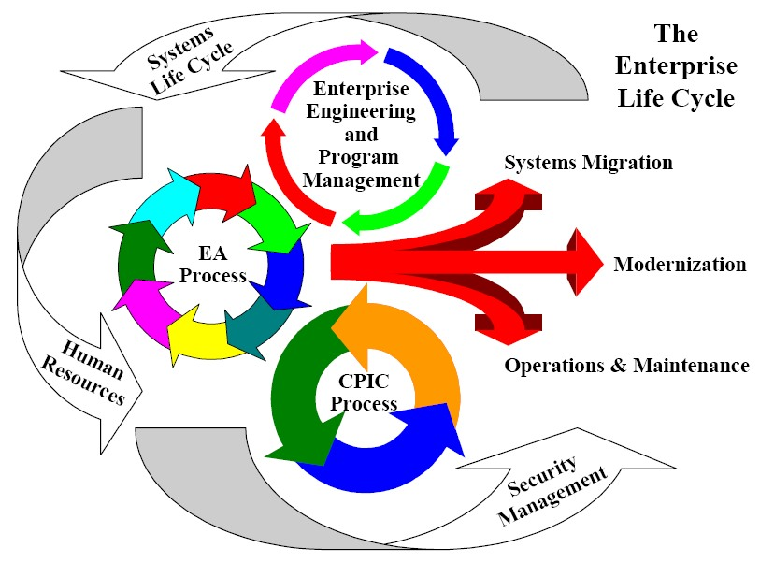
You should know!
What are the SNAP-Ed Program Specific goals & objectives outlined by the state?
How do/will your project goals fit into these objectives?
Again, we are not trying to create a new program; we are trying to fulfill the Specific Goals of the SNAP-Ed program
Always keep in mind, “how is the work I’m doing fitting into the goals of the overall program I’m working under?”
Notes:
Take the time to learn what the Program goals are, that way when we set up our Project goals we are in line with what the program is trying to accomplish through our actions.

Slide 15
La Paz County Program goals and Objectives
By September 30, 2018, three or more family-friendly physical activity opportunities will take place each year in La Paz County.
  Develop a collaborative action plan with Parker Parks and Recreation and La Paz County Public Health Educators and Prevention Program to promote physical activity events.
  Implement the action plan (a) with partners, Parker Parks and Recreation and La Paz County Public Health Educators and Prevention Program, to promote physical activity events.
    Number of communities reached
    Number of physical activity opportunities provided
    Number of partnerships in place

Slide 16

Why Project Design
The last slide shows you a small part of the La Paz County Work Plan for active living in the SNAP-Ed program. It gives us a good road map to work toward within the program. However, why is it important to design and manage our individual projects and workshops within the program parameters?
Clear objectives help us maintain the direction of the program and help ensure we are successful in our endeavors.
This will also provide a clear explanation to the state of what we are doing within our counties and the actions are taking to get there.
This will also help us and the state know how and where we are going to spend money and why.
Notes:
Yes, yes this is a lot to take in and for many of you this is not something you think is important to your specific jobs or roles in the program. However, if we are a representative of the program and are conducting workshops… meeting with site staff and promoting our services we should have an idea of the projects and workshops we wish to accomplish at each site. It does no one any good to play basketball without the ball. Being prepared will only strengthen the work and services you wish to provide.

Slide 17

Action Planning
Action Plan Components:
  Tasks for each project objective
    What are reasonable and attainable tasks that lead to accomplishing the objective?
    Why is this specific task important to the project and ultimately the program?
  Roles & responsibilities for all stakeholders
    community, project team, Volunteers, others…
  Timeline for completion of the project/ workshop
    What is the estimated time each phase will happen; when do you expect to start?
    Will it end after one or a few times, or will it be ongoing for the foreseeable future?

Slide 18
Action Planning:
Identifying & Sequencing Tasks
Tasks
  Concrete and very specific activities that must be completed to achieve the project objectives.
  Set clear and attainable goals that support your objectives.
  Each objective has its own set of tasks.
    For our workshops the time frame we provide to a site for when we will start and complete, including data collection if needed.
  Need to be arranged in logical order that ensures completion of the project.

Slide 19
Action Planning:
Assigning Roles & Responsibilities
Function | Question
Inform | Who are the people you need to keep informed about major decisions and progress on the project?
Consult | Who are the people that may offer consultation to the project (provide technical information, insights to help with decision-making, etc.)?
Perform | Who will be directly involved in carrying out the work (the actual “do-ers.”)?
Oversee | Who will oversee and give timely approvals for the work (responsible for seeing that the work gets done)?
Animate | Who will encourage and mobilize people to get involved and stay involved?

Slide 20
Action Planning:
Making the Timeline
Need to consider:
  How to sequence the project tasks so that each one prepares for something that follows
  When various tasks can/should take place over the life of the project’s implementation
Tools:
  Seasonal calendar
  Daily activities schedule

Slide 21
Timeline

Slide 22
Resource Identification & Budgeting
Types of Resource Requirements:
  Human Resources, Labor
  Equipment, Materials, Supplies
  Transportation and other costs
As the overall budget is already set within the program, we are not talking about making an in-depth budget proposal. However, think about costs and items that may not be specifically in your county budget that you may need for this project. Planning ahead will cut down on project delays and help the project run smoothly

Slide 23

Resource Identification & Budgeting
Two Types of Costs
  One-Time
    Equipment
    Infrastructure improvement
  On-going (fixed and variable)
    Rent (fixed cost)
    Supplies (variable)
    Salaries (fixed)
    Transportation
    Utilities, maintenance
    Etc.

Slide 24

Sources of Budget Information
Project Action Plan
  What are the costs of carrying out the project tasks?
  How will this impact our program budget?
Timeline
  At what point(s) in the project will the costs be incurred? (one-time vs. on-going)
    For nutritional workshops with a specific theme, purchasing specific items can add up; for physical activity, equipment and materials can also have an impact.
Research
  Where can you get the information on projected costs of specific items?
  For new items that are needed but which were not initially included in the budget, we need to let everyone know where we may purchase the item and how much it will cost (use the UA procurement system whenever possible)
    Have a back up plan in case it’s out of stock or the price increases.
Notes:
NOTE: you should also make sure that the items are an allowable expense. If they are not, but are needed in order to complete the project, then another source of funding will need to be found. IF other funds are NOT available, then we need to either seek in-kind contributions or find another project that will achieve the objective.

Slide 25

Budgeting To Do’s
Budgeting Brainstorm…
…….Within reason!
  Don’t try to buy a supply for hundreds of dollars if we can find it cheaper with a little research.
“Window Shopping”
  Amazon and other online resources are a great way to shop to plan a budget and have a true idea of total costs.
Use/Get the program budget
  talk your Program Coordinator or Regional Coordinator and discuss current programmatic needs and restrictions.

Slide 26
Budget Get Out & Play Day
 | PROJECT TASKS | Quantity | MATERIAL COST ($) | Tax/ Additional charges | TOTAL PER TASK
PROJECT DEVELOPMENT | EZup tents | 2.0 | $446.60 | $300.00 | $1,193.20
 | Tables | 1.0 | $67.00 |  | $67.00
 | Table Cloths | 4.0 | $9.84 | $3.09 | $42.45
 | Table Runners | 4.0 | $3.23 | $3.28 | $16.20
 | Chairs | 4.0 | $22.00 |  | $88.00
 | Igloo Coolers ( 5 gallon) | 2.0 | $19.86 |  | $39.72
 | Storage Bins | 4.0 | $73.99 | $26.05 | $322.01 | Current Spending amount
 | Ice Chests | 2.0 | $49.97 |  | $99.94 | $1,654.87
 | Subtotal | 8.0 | $692.49 | $300.00 | $1,868.52
PROJECT MANAGEMENT | Project Posters (Staples http://www.staples.com/Custom-Posters/product_349510) | 20.0 | $9.99 |  | $199.80
 | Project Flyers (Staples http://www.staples.com/Custom-Flyers/product_335826) | 200.0 | $17.99 |  | $3,598.00
 | Groceries For Food Demo | 1.0 | $1,200.00 |  | $1,200.00
 | Groceries For Healthy Snacks | 1.0 | $1,200.00 |  | $1,200.00
 | Subtotal | 222.0 | $2,427.98 | $0.00 | $6,197.80
Total (Scheduled) |  | 230.0 | $3,120.47 | $300.00 | $8,066.32

Slide 27
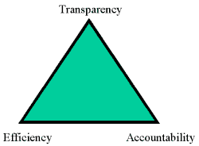
Along with Budgeting Comes…
Accountability
  Who? What? When? Where? Why?
  Small items may not seem important at the start, but over the life of your project they can add up.
  Consider the cost for supplies for a cooking demonstration or materials you may need for an active living workshop that may not have been included in the program budget.
Plan for financial management of project
  Never assume someone is keeping track of expenses for you. Keep track of each purchase and do your own research.
Documentation of resources and spending
  A simple system, who has it and where is it?
  A purchasing card use form that details the purchase to ensure proper spending.
  Who has the supplies/equipment – where is it? This helps keep track of supplies and prepares us for the future.

Slide 28
Monitoring & Evaluation Planning
Monitoring
  Tells us if the program is on track and if we are making progress (a snapshot in time)
Evaluation
  Tells us if our program is on the right track and having the impact we hoped it would.
    Are the projects/workshops we are implementing having the impact we were trying to accomplish?
  The Evaluation team has the responsibility for monitoring the specific SNAP-Ed program performance. These measures are typically set by AzNN and the UANN Evaluation team. However, it is important that we set our own standard for our specific projects/workshops and a way to measure their effectiveness to ensure we are reaching the specific goals we set for them. Is the project successful as implemented? Are there changes we could make that would ensure success for our participants?

Slide 29
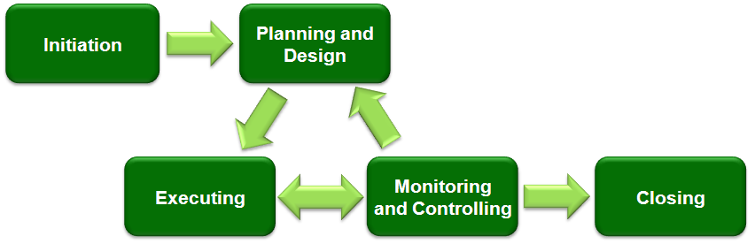
Characteristics of Successful Projects
Involve the community and are what the community wants to do.
Realistic and concrete project/workshop objectives.
Clearly defined tasks and responsibilities for all people involved.
Time frame and budget are well designed.
Concrete, and tangible results achieved during the project.
Effective monitoring system that measures the project’s progress,
Methods for keeping the larger community informed and involved.
  Advertisements: “Was every eligible participant informed?”
Evaluation designed and based on indicators set beforehand for each project phase and the entire project at its conclusion.

Slide 30
Wrapping Up
Open Discussion:
  How can we use the AL subcommittee in FY17 to help develop new ideas and potential new directions/ execute current ideas for our individual SNAP-Ed county programs moving forward?
Call for new agenda items

